Slide 1

What’s next for
deep learning for Search?
Bhaskar Mitra
Principal Researcher
Microsoft Research

Slide 2
A (personal) reflection on the journey so far…
Notes:
We are all familiar with the saying “if all you have is a hammer then everything looks like a nail”.

Slide 3

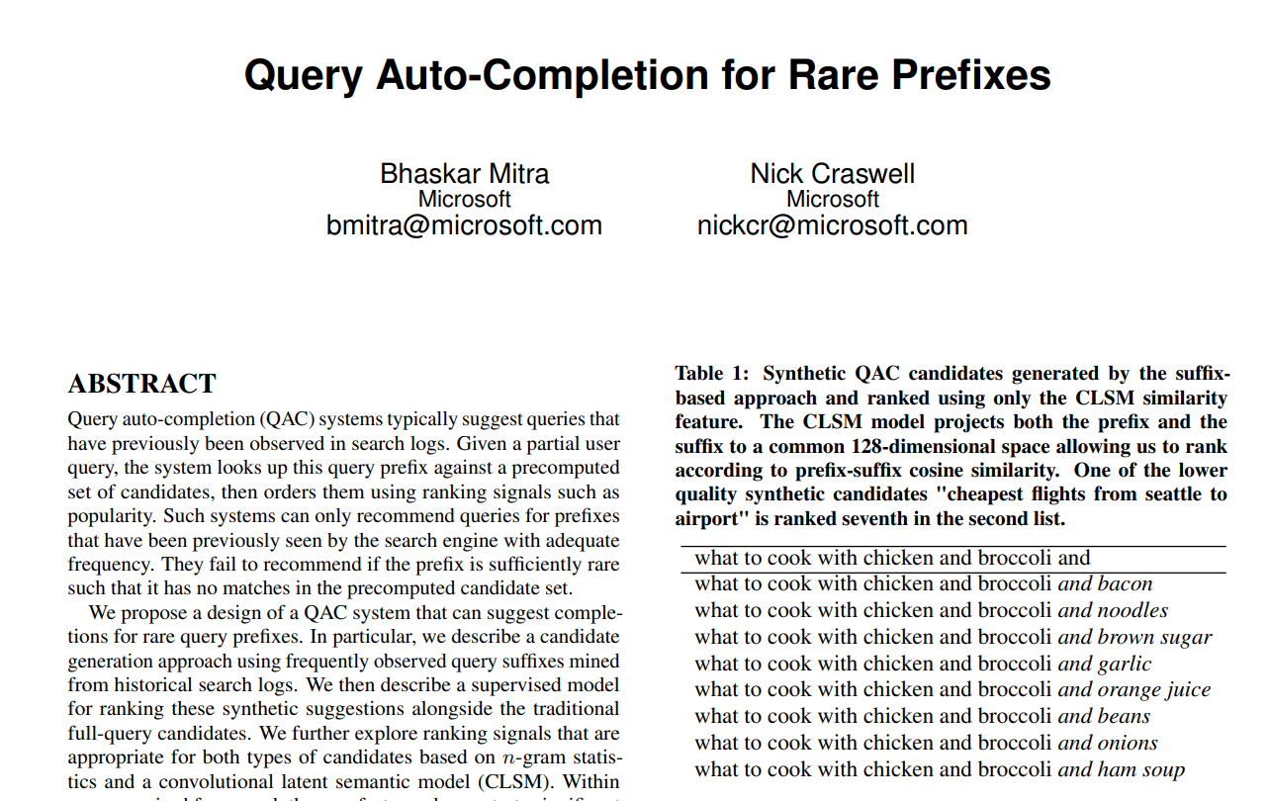
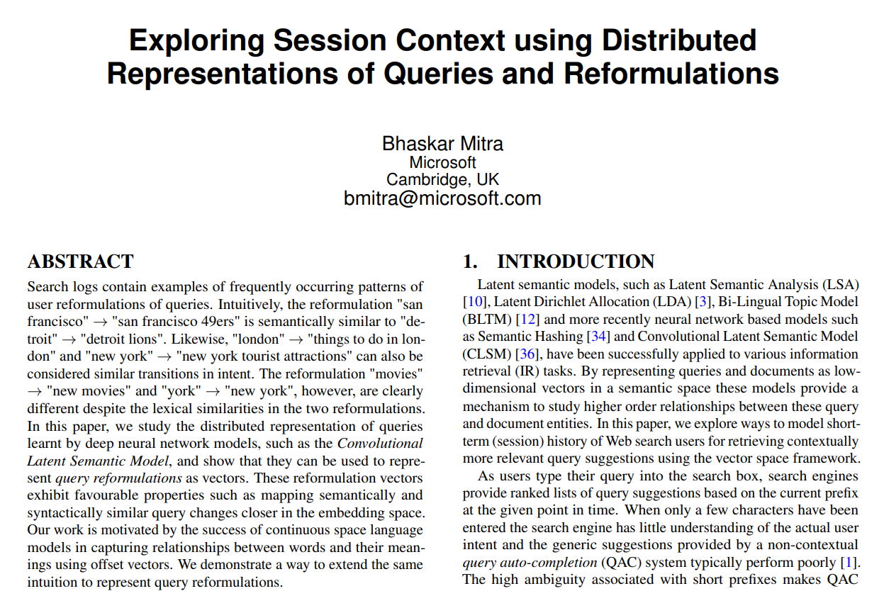
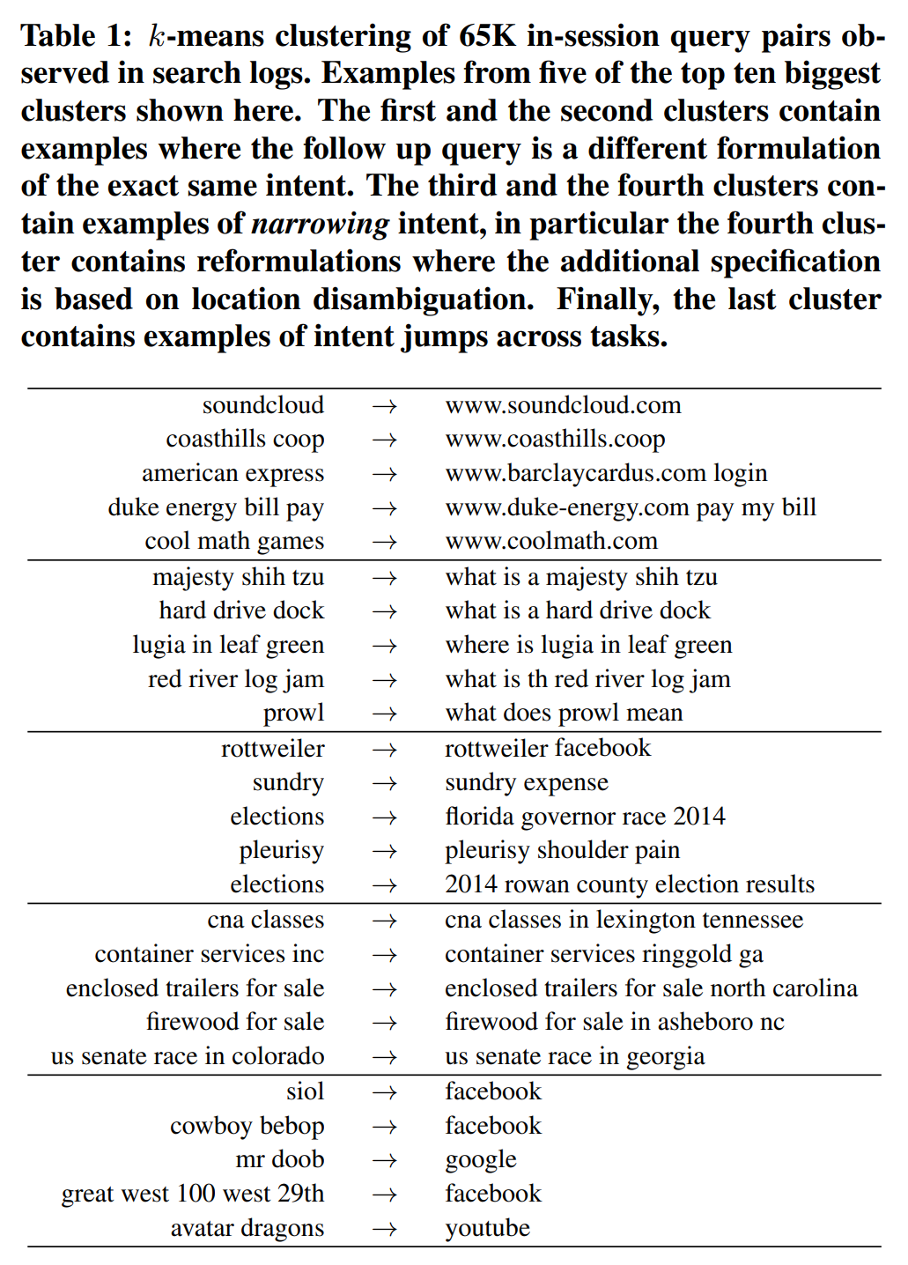
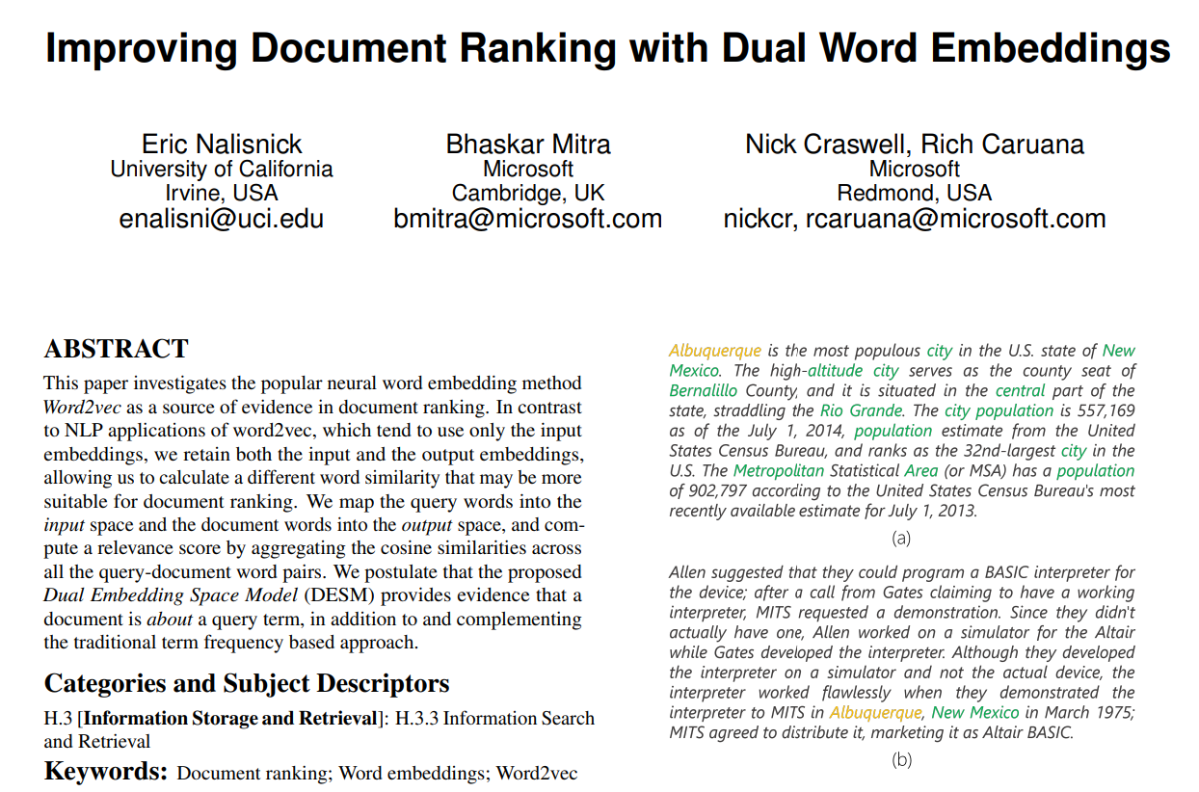
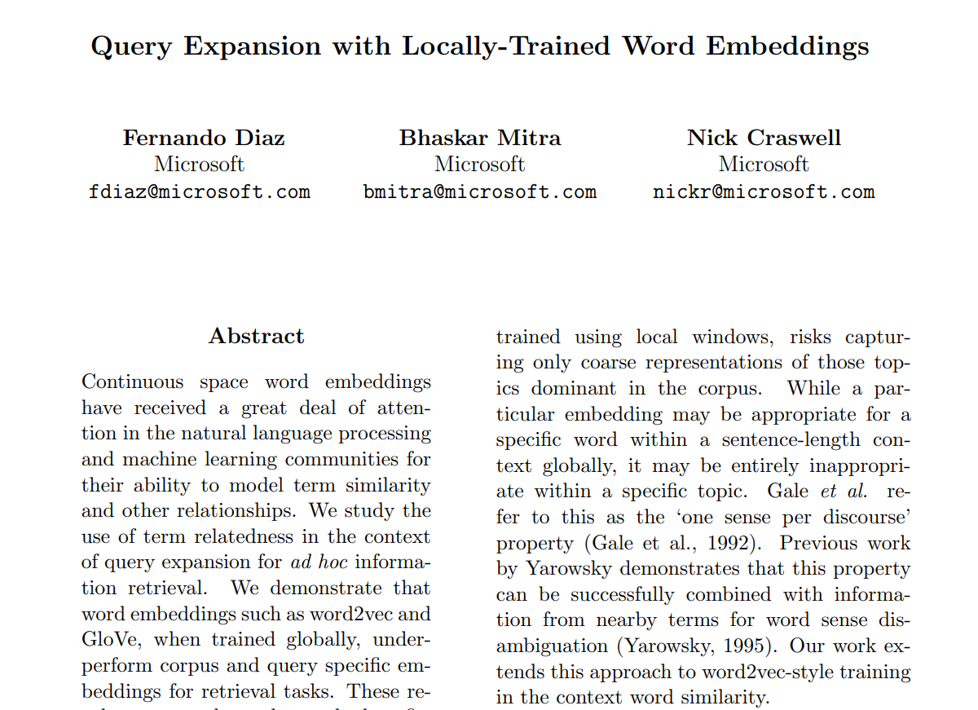
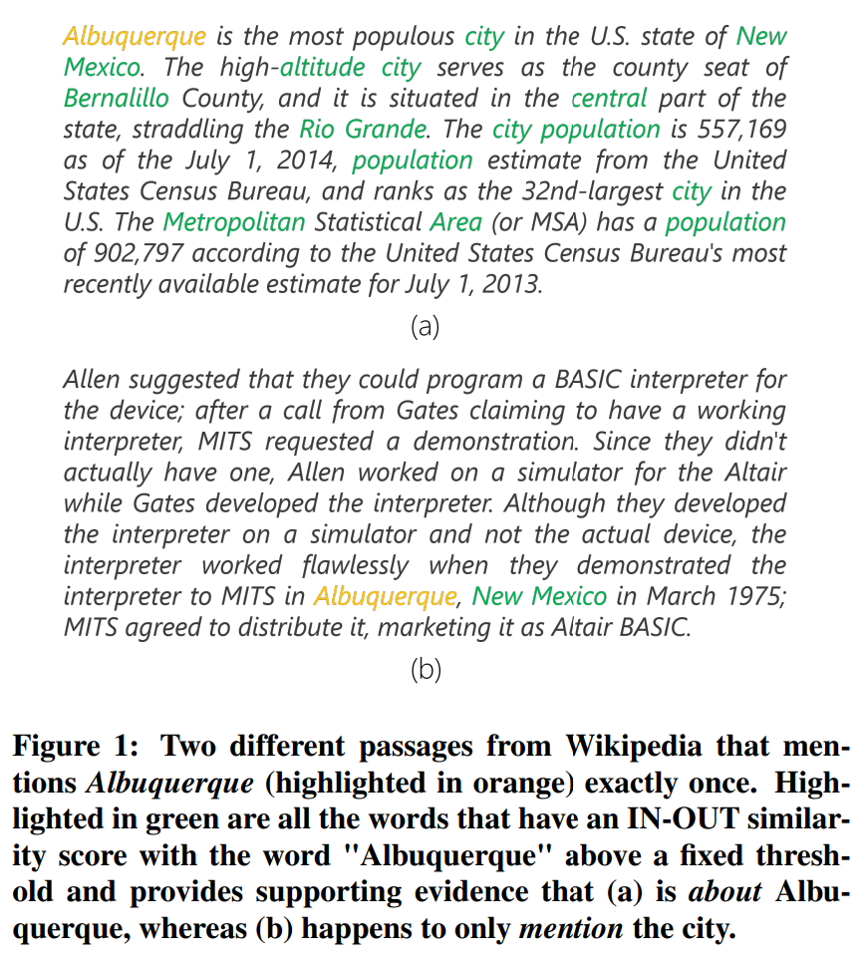
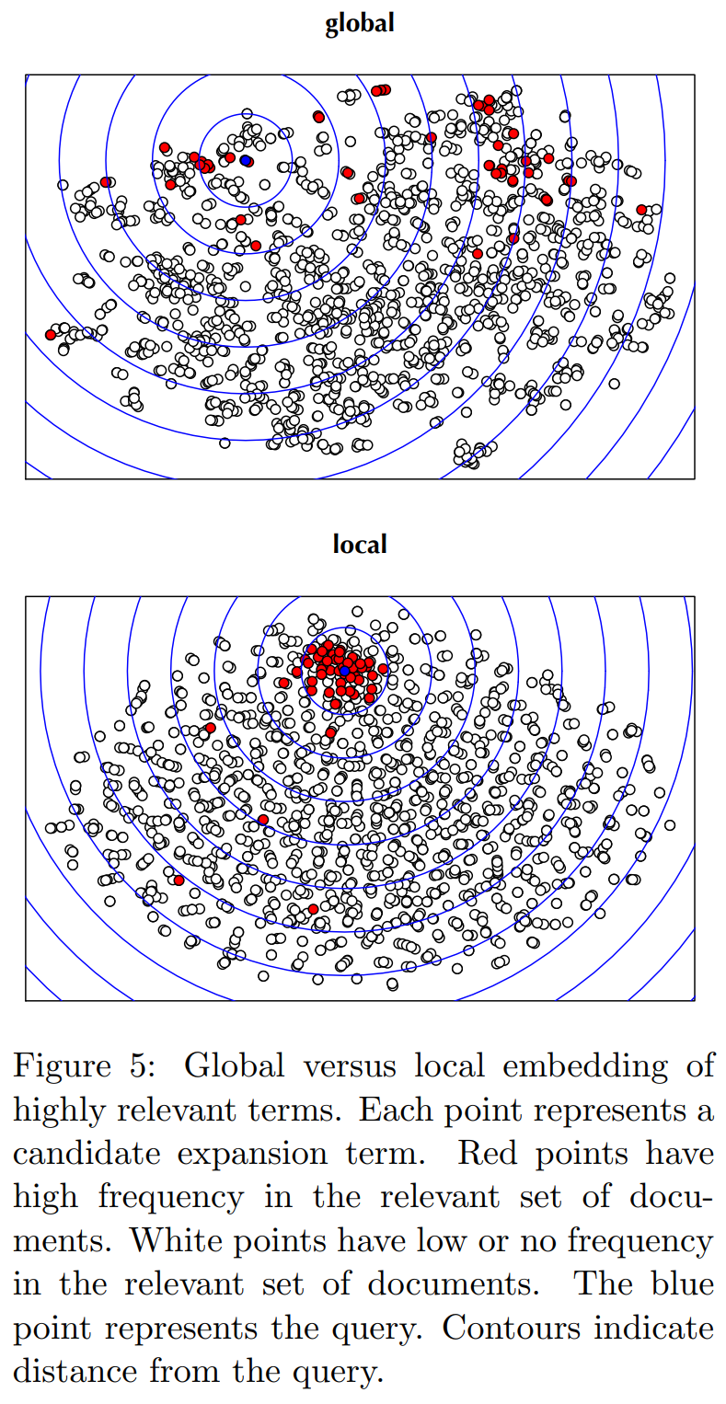
2014-16

Slide 4

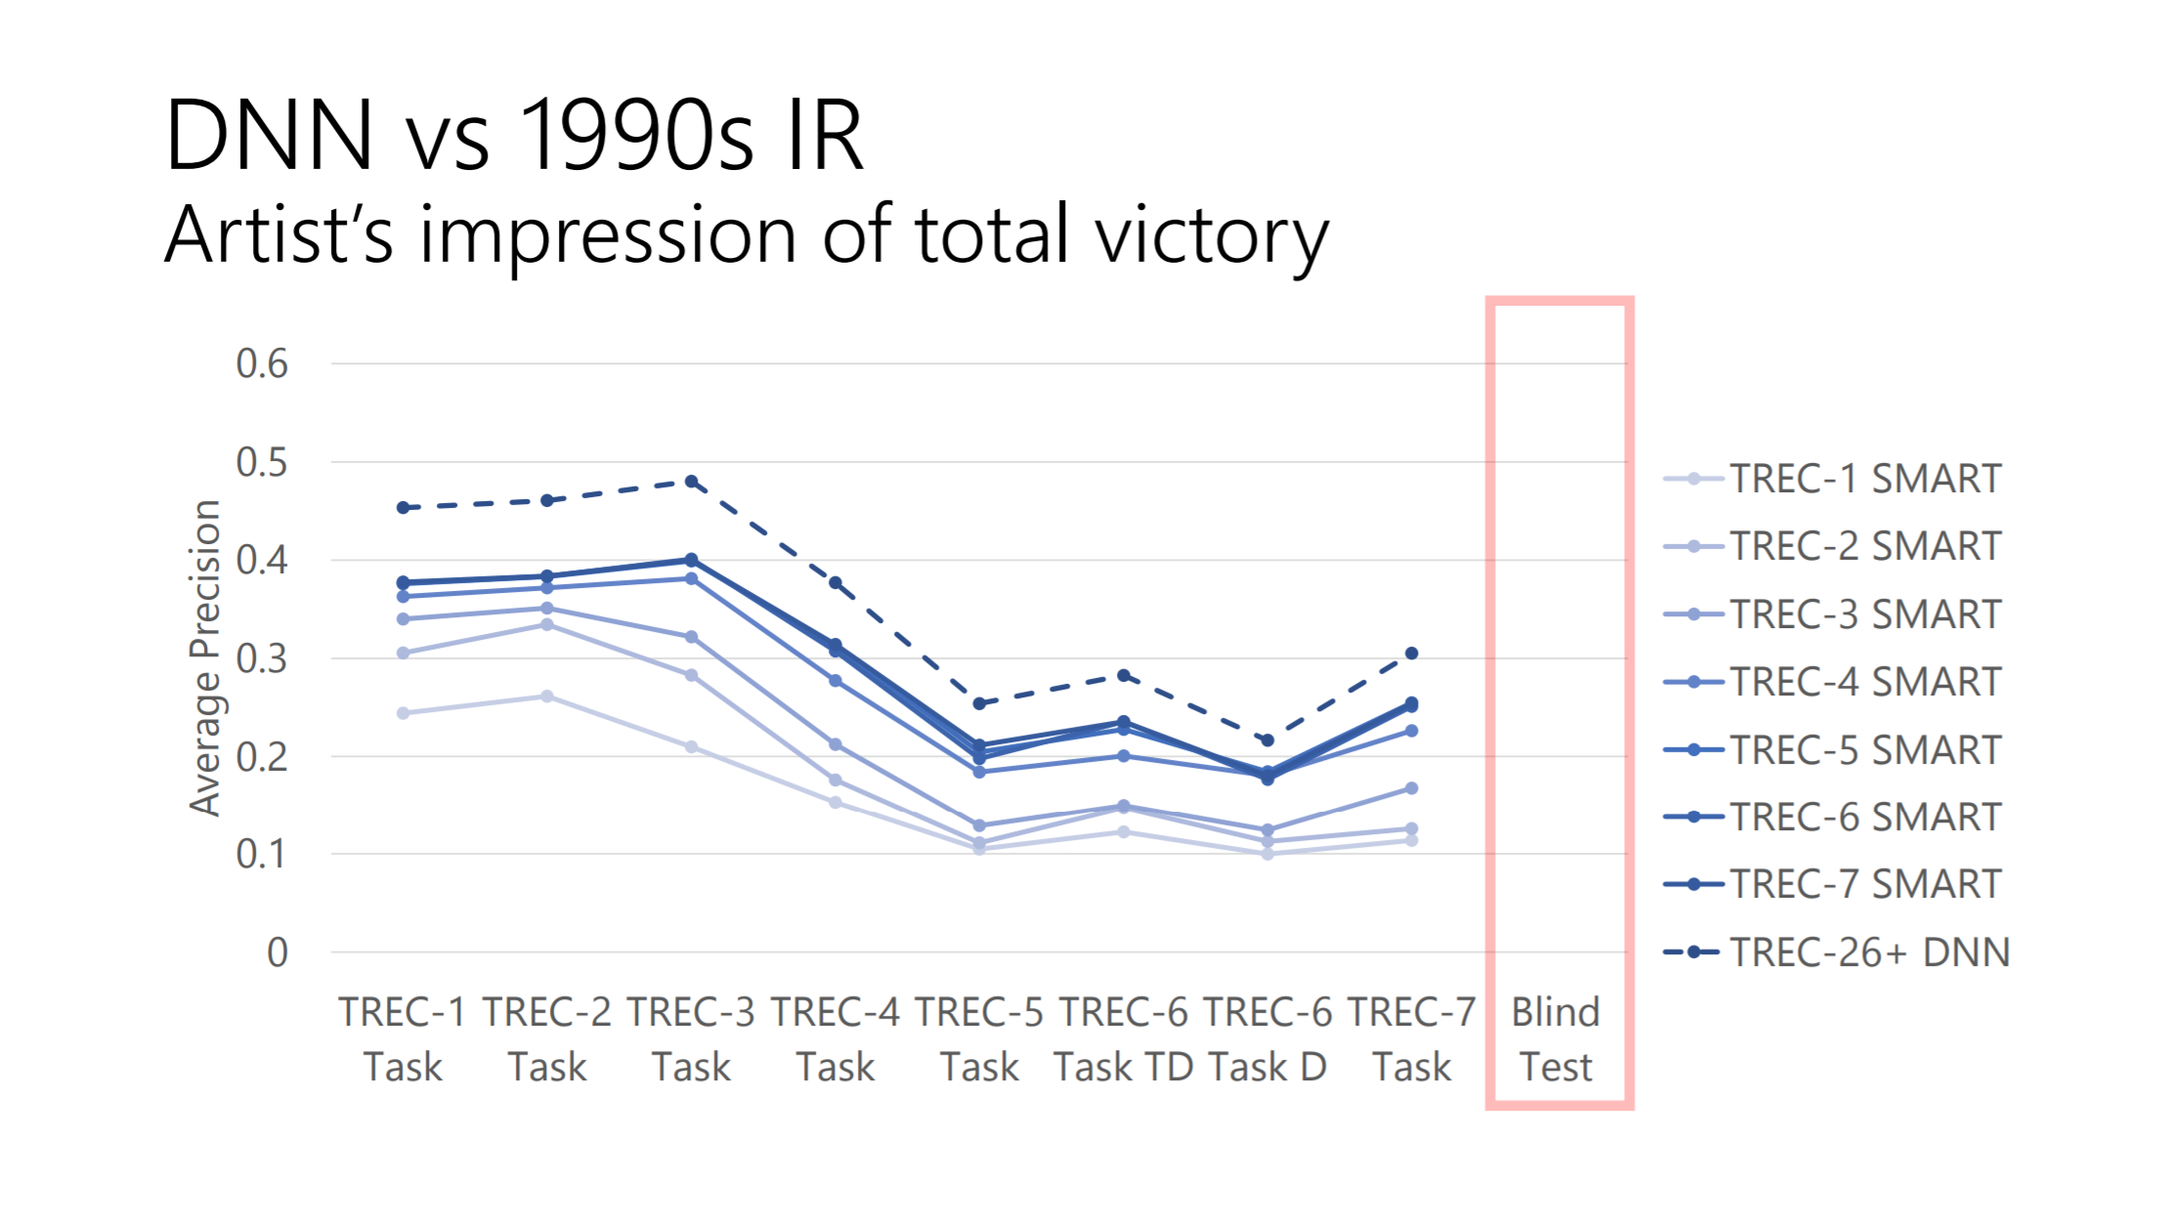
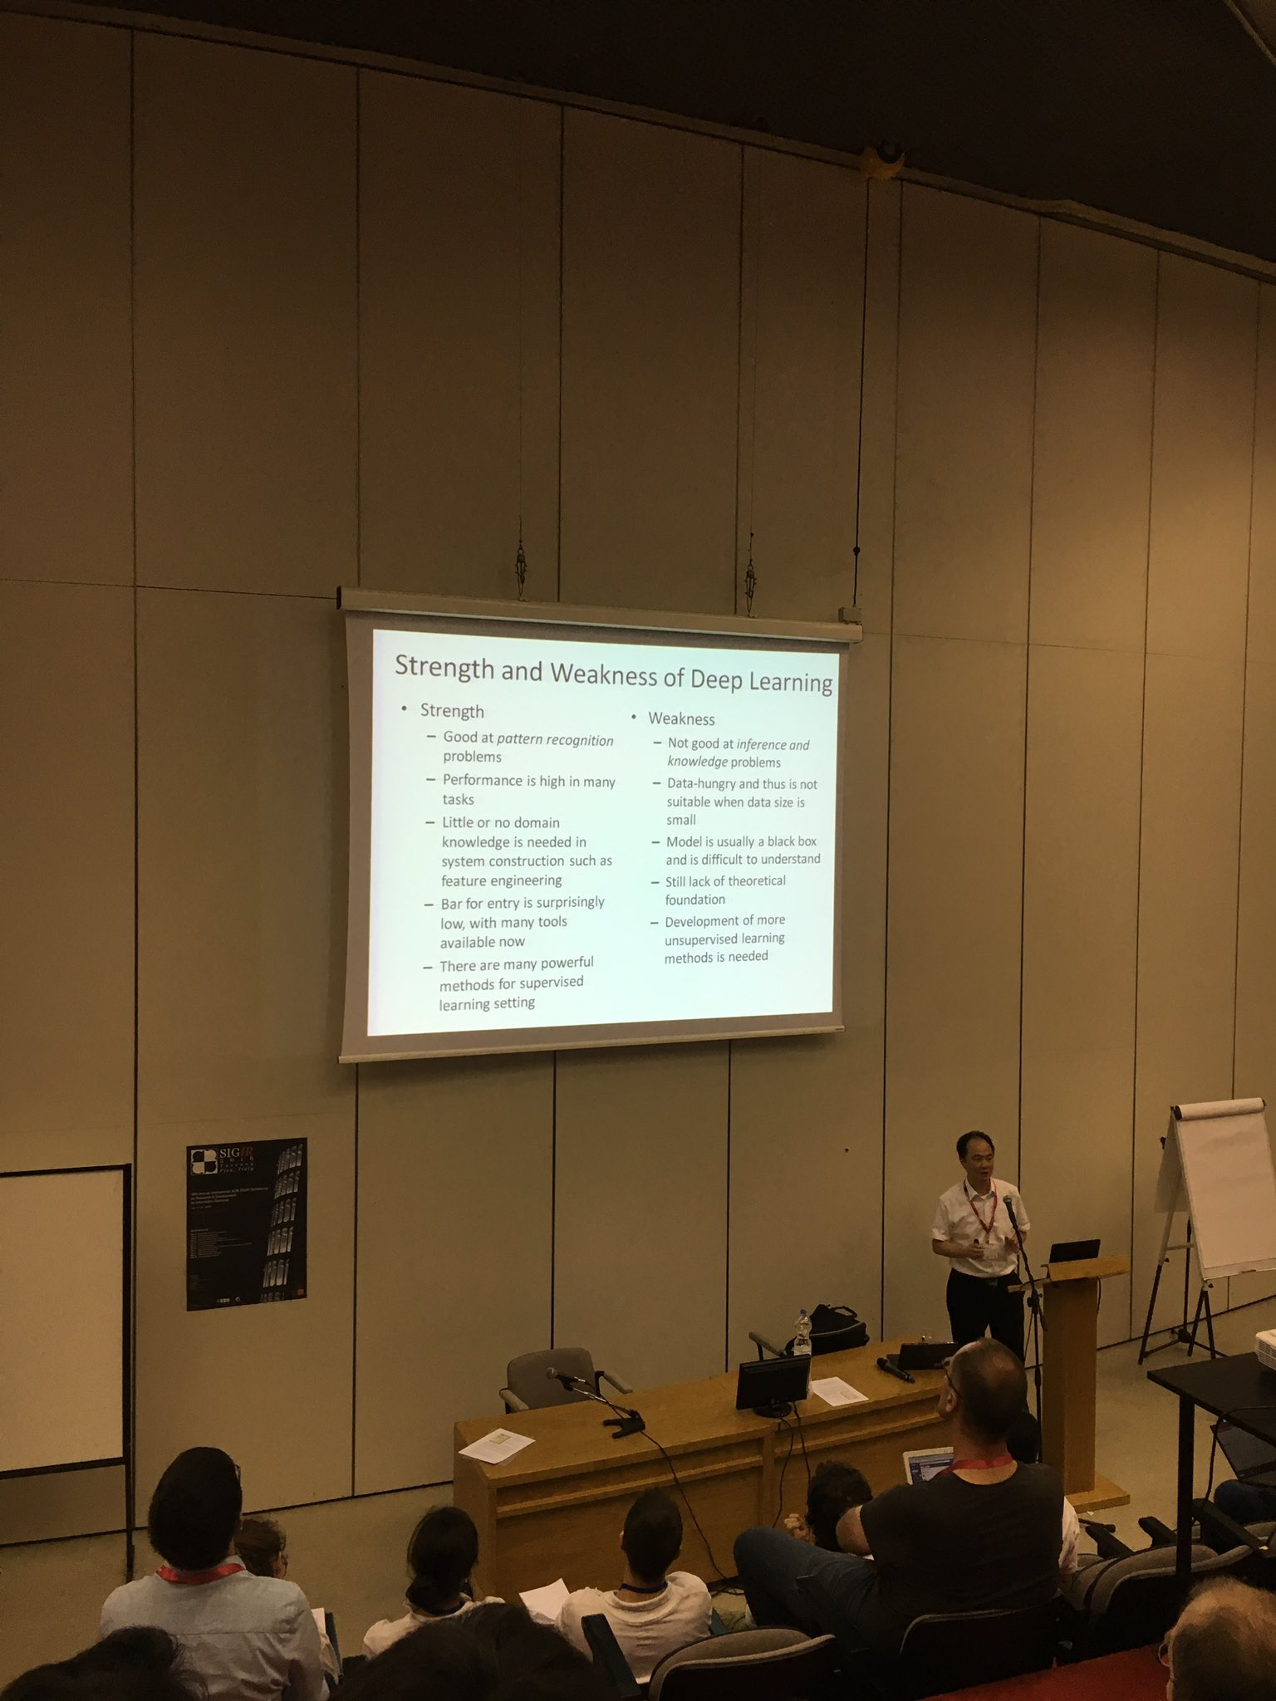
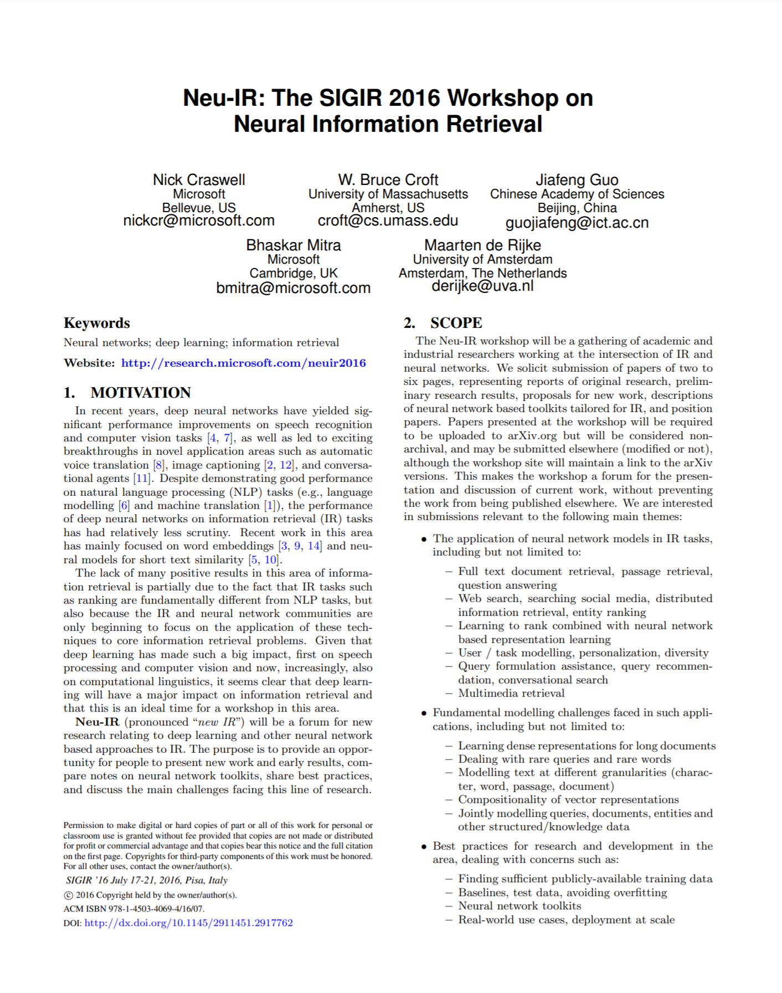
2016

Slide 5
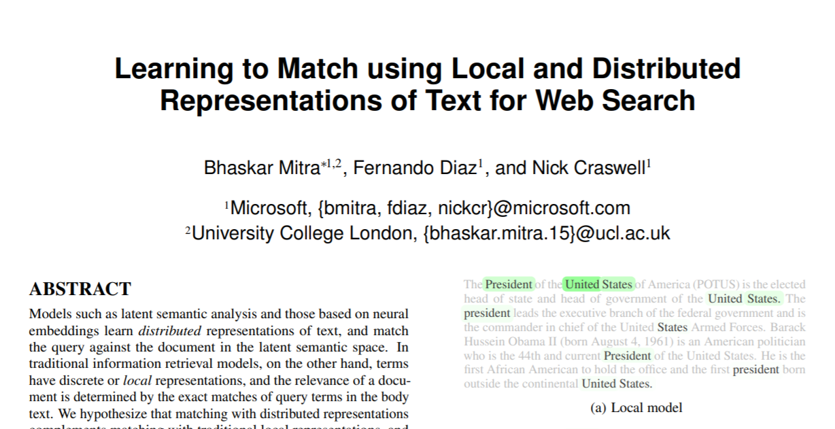
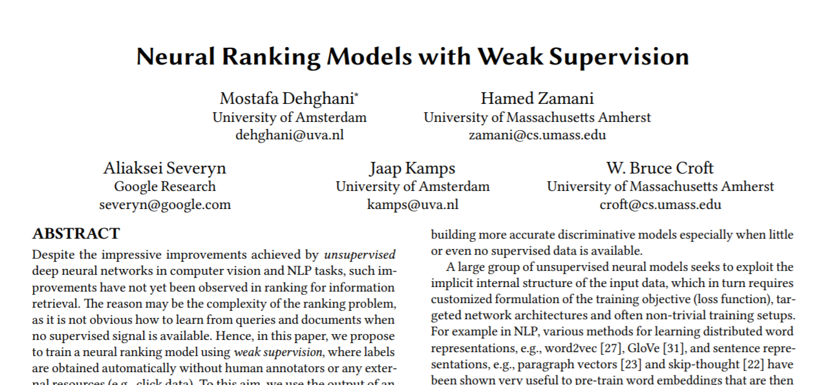
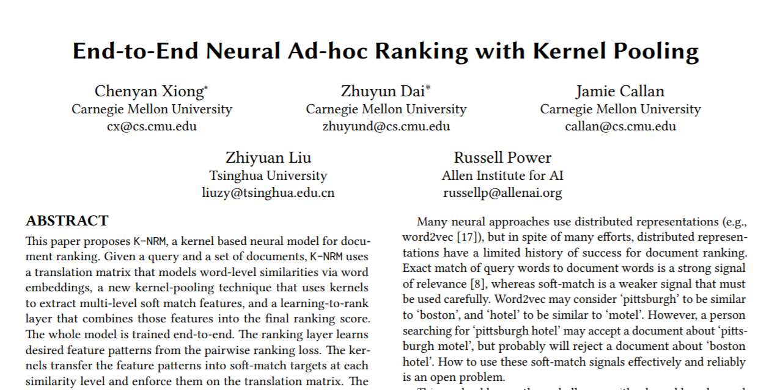
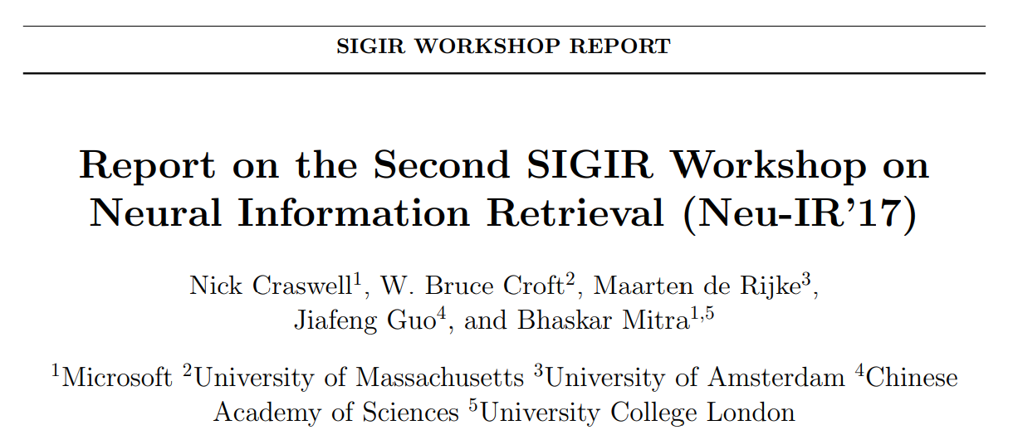
First wave of deep document ranking models
2017
Duet
Weak supervision
Trained on 200K English queries from Bing.com (proprietary dataset)
KNRM
Trained using BM25-based weak labels
Trained on 95K Chinese queries from Sogou.com (public dataset)

Slide 6
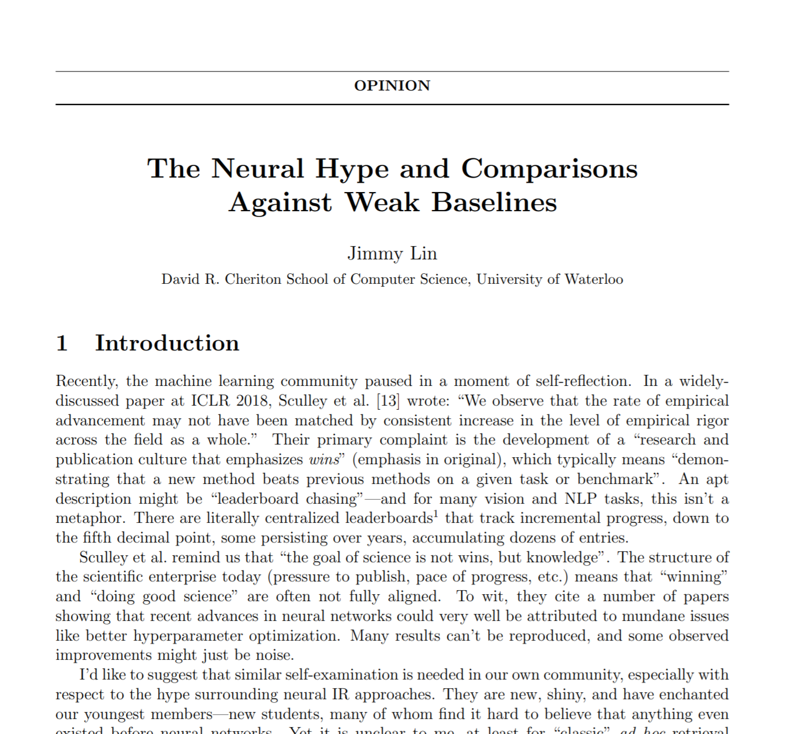

2018
But are we making real progress?
¯\_(ツ)_/¯
MS MARCO passage ranking benchmark launches with 0.5M+ English training queries
The myth of “no neural IR model worked before BERT”: first generation deep ranking models, e.g., Duet and KNRM, and their variants, outperform most traditional IR methods by reasonable margin on the MS MARCO benchmark
Passage Ranking Leaderboard

Slide 7
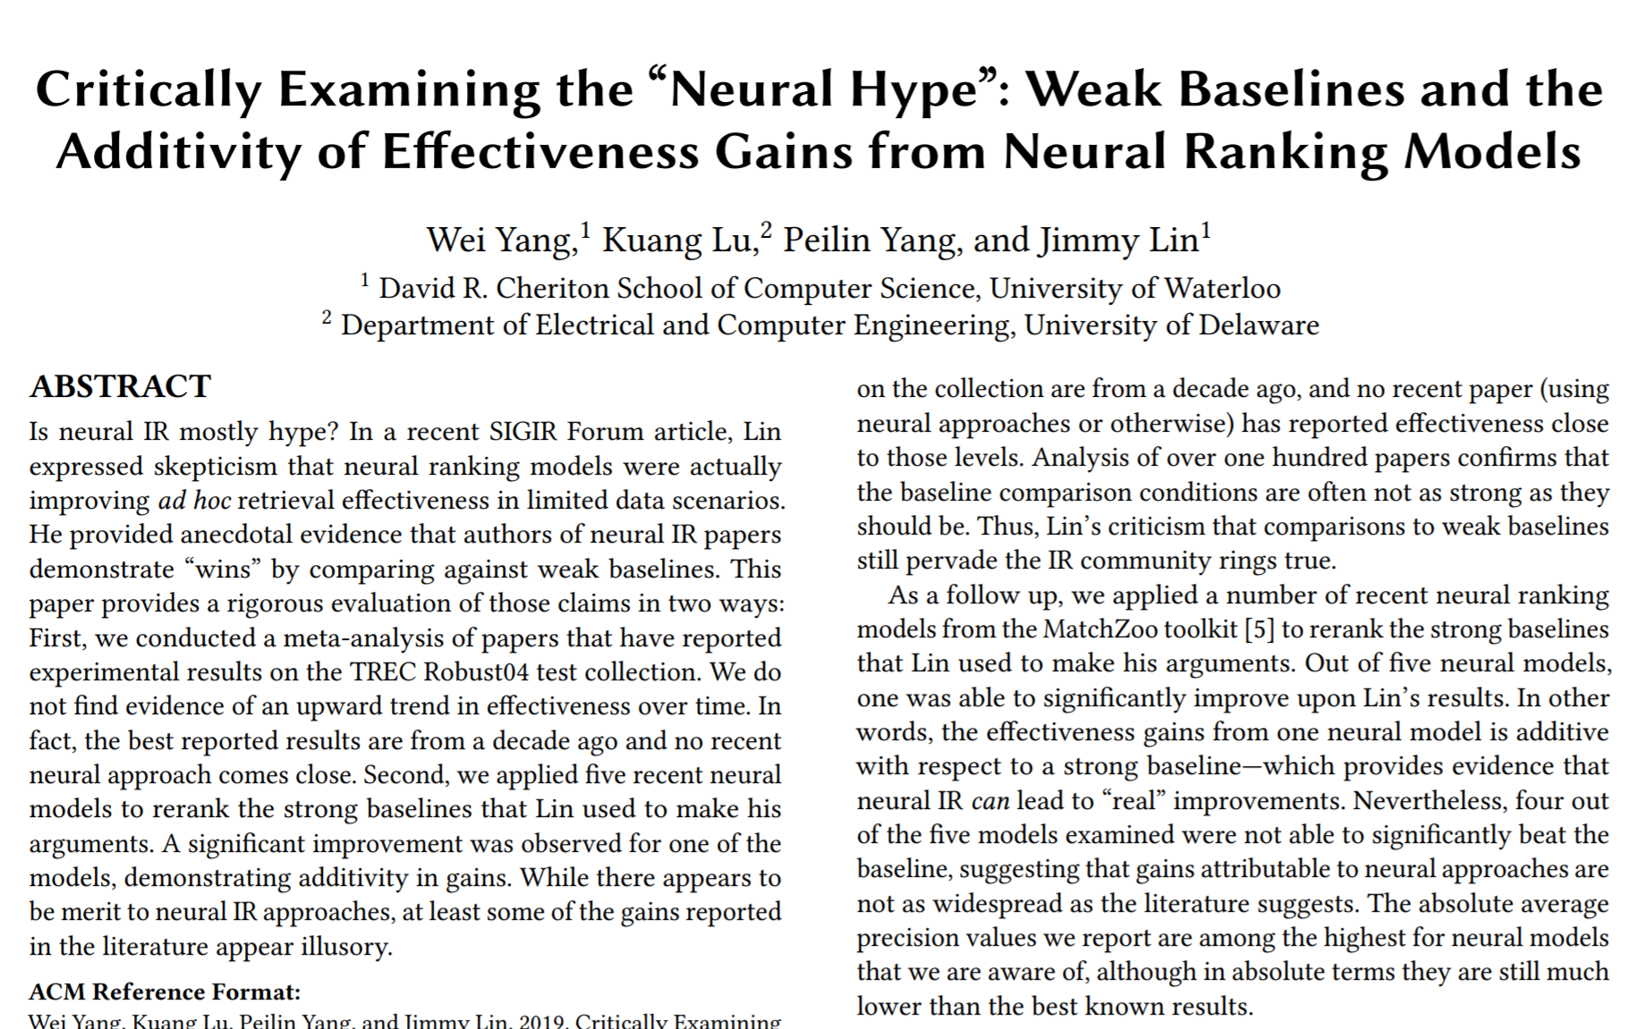
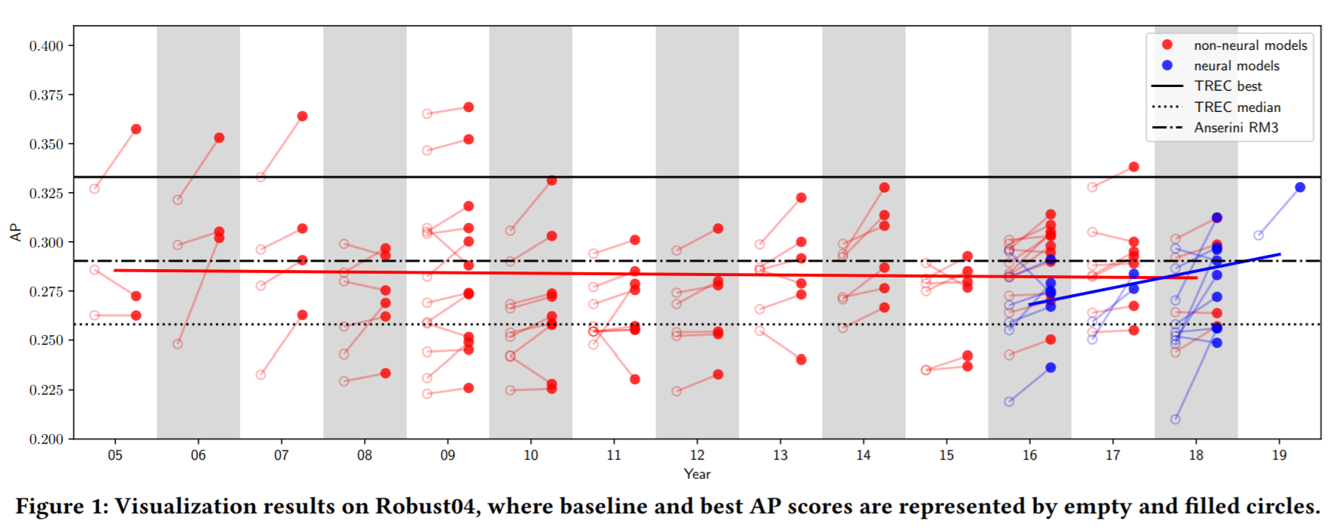
Did neural IR really have a “weak baselines” problem?
I will argue NO: (i) pre-MS MARCO, most neural IR papers benchmarking on Robust04 were NOT trained on large labeled datasets and represent a biased sample of neural IR papers, and (ii) even in those cases there is little evidence that these papers employed any weaker baselines than non-neural IR papers
Why is this important?
1. Can’t expect every paper to beat SOTA. Focus is often on hypothesis testing. Check for appropriate baselines, not SOTA baselines. Improvements over emerging methods (not yet SOTA) should be encouraged.
2. Early generation deep ranking models provided many useful insights and created the demand for large training dataset. 👏🏽

Slide 8
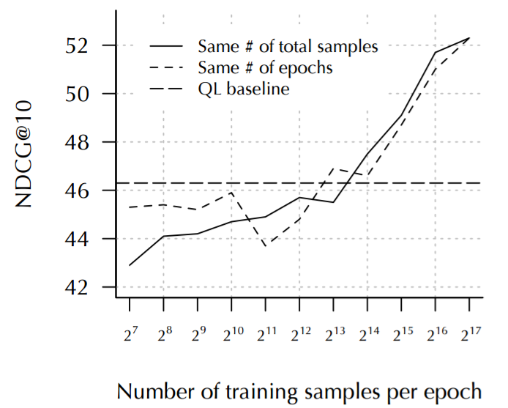

But we had a BIGGER benchmarking problem
The lack of public IR benchmarks with large scale training data led to:
Comparisons under low-data regime
e.g., older TREC collections with few hundred queries
Comparisons on (semi-)synthetic benchmarks
e.g., TREC CAR
Comparisons under weak supervision training
Comparisons on corpus of language different than what the models were designed for
Performance of deep models typically improve with more training data
(image source: The Duet paper)
Non-standardized benchmarks also required reimplementation of baselines (specially, neural baselines) which in turn meant that many of them were under-tuned, in turn, contributing to the “weak baselines” problem!

Slide 9

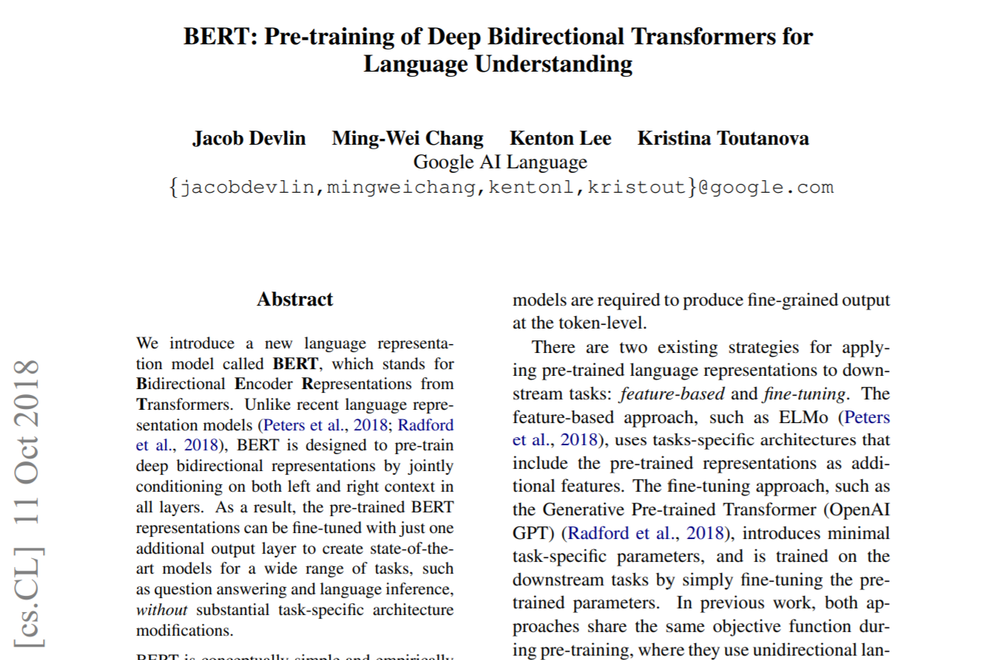
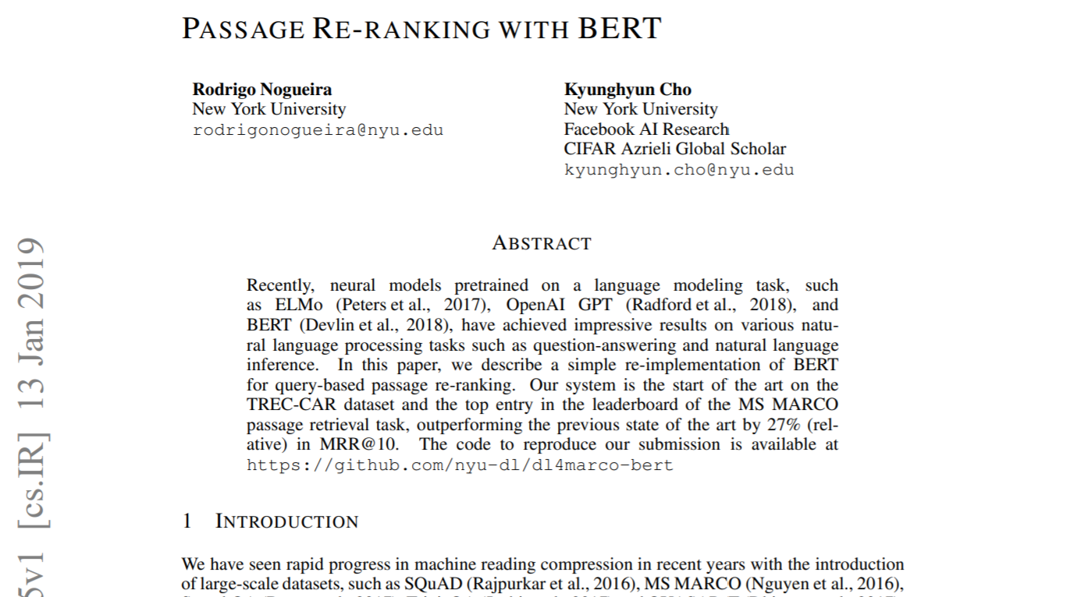

The year of BERT
2019
Three months after the BERT paper hits arXiv the first BERT-based reranking model achieves 0.359 MRR compared to previous state-of-the-art of 0.281 on MS MARCO

Slide 10
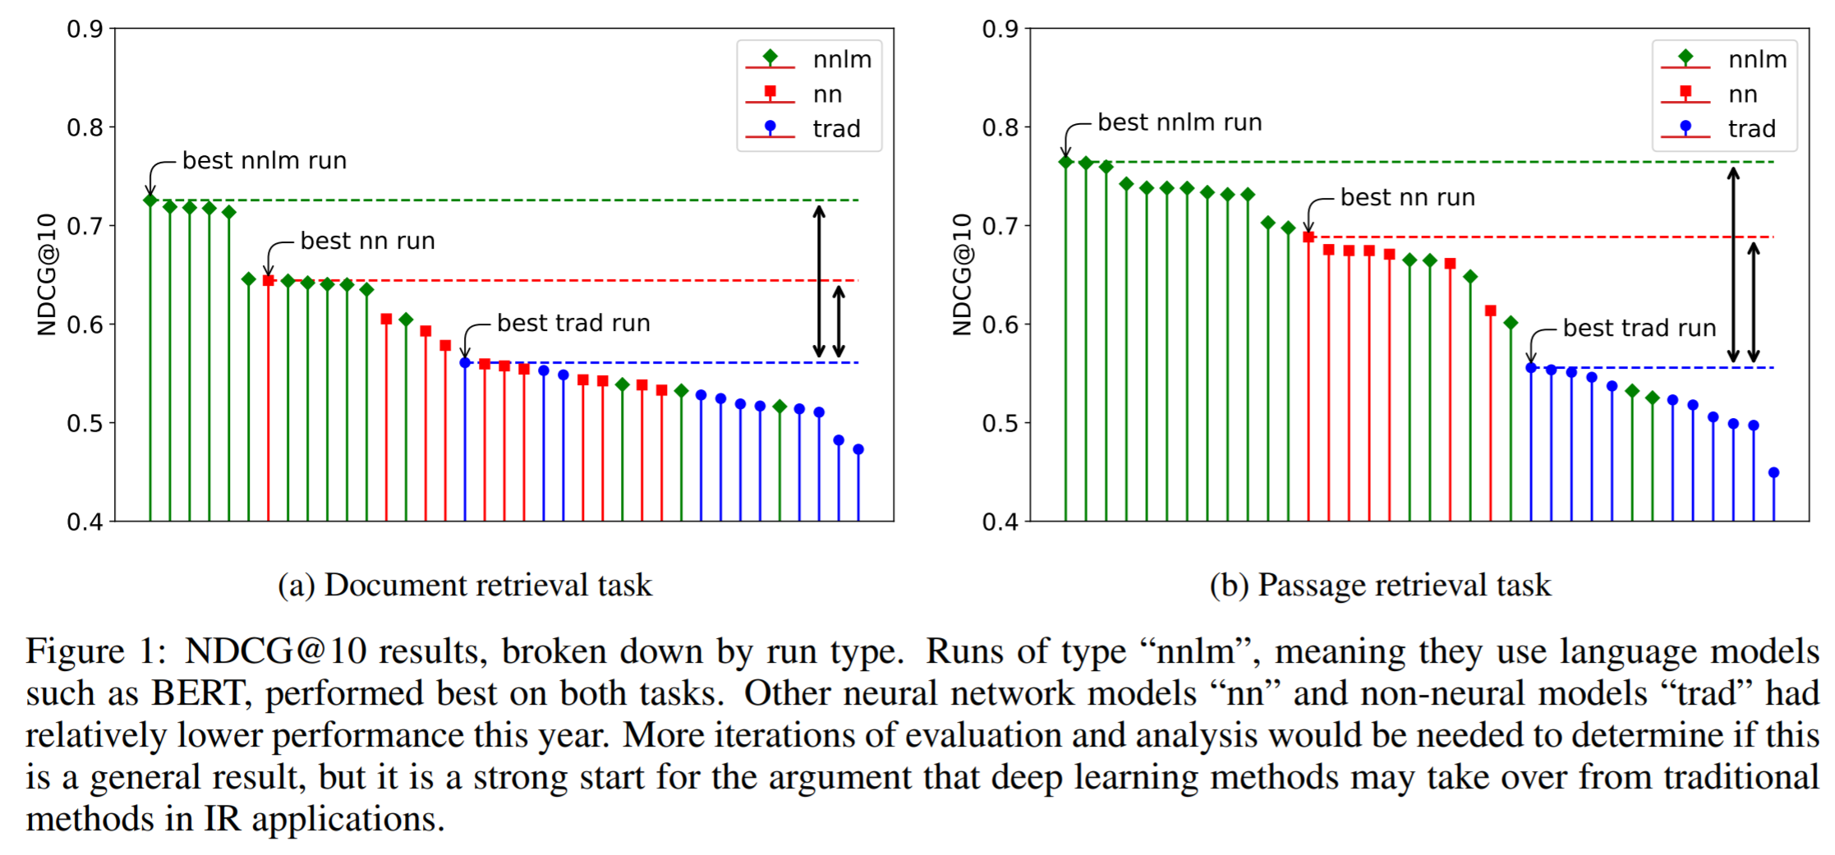

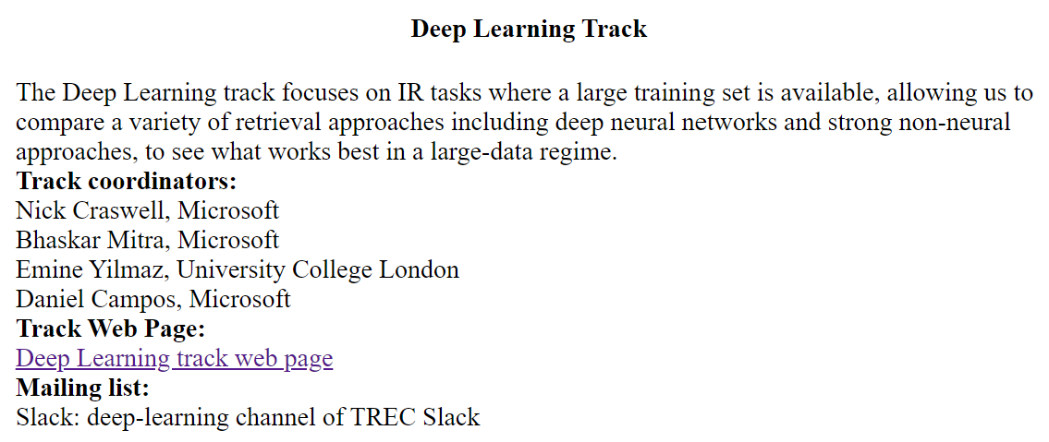
TREC Deep Learning Track
2019

Slide 11
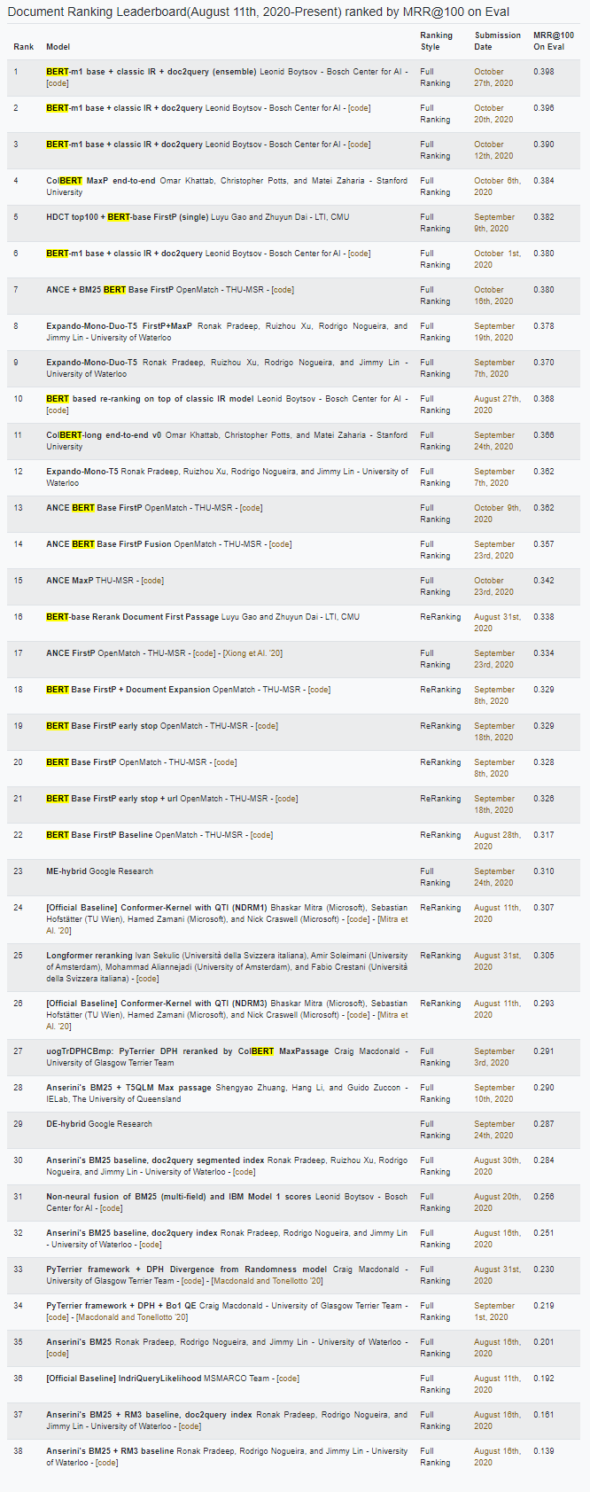
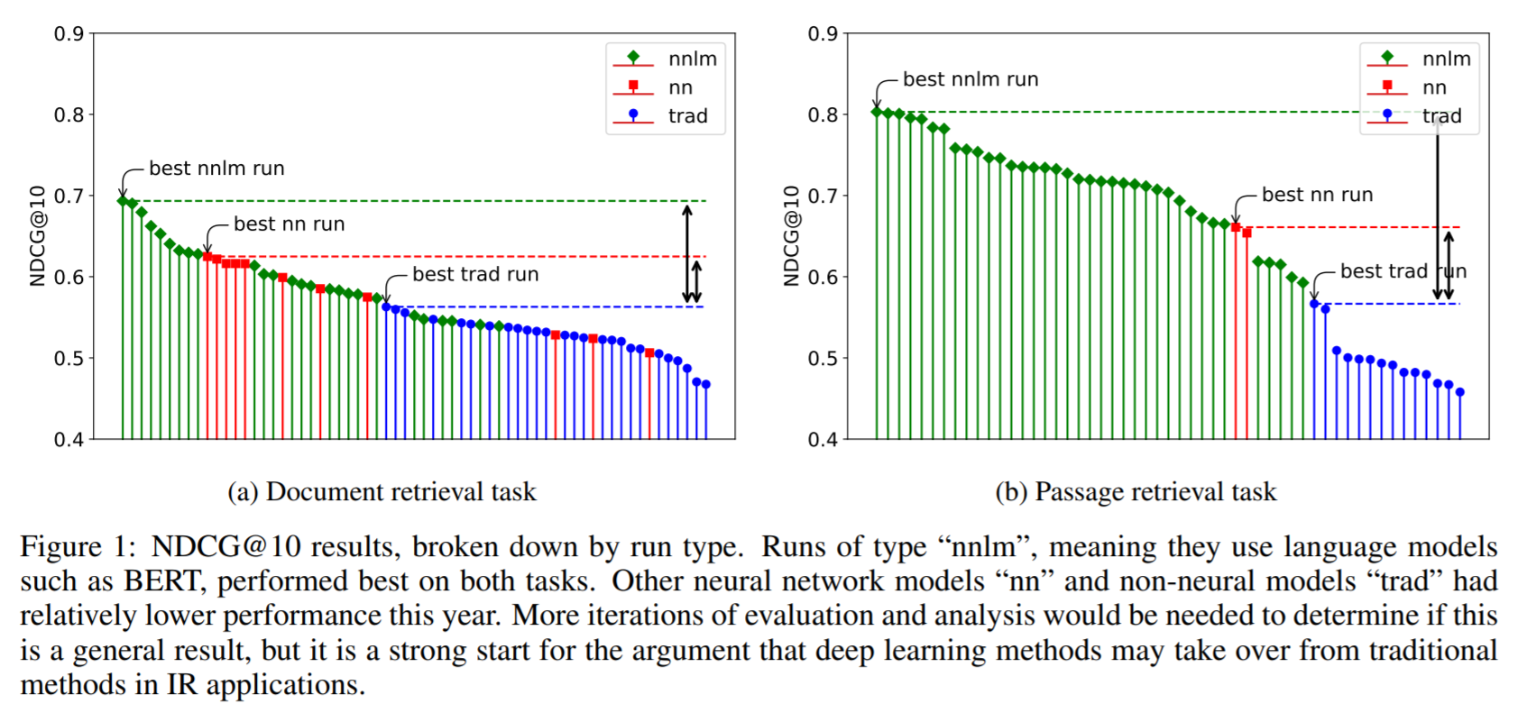

2020
Next year (2023) we will be hosting the 5th edition of the TREC Deep Learning Track 🙌🏽
Document Ranking Leaderboard
+
TREC 2020 Deep Learning Track
Also, this guy
😒👇

Slide 12
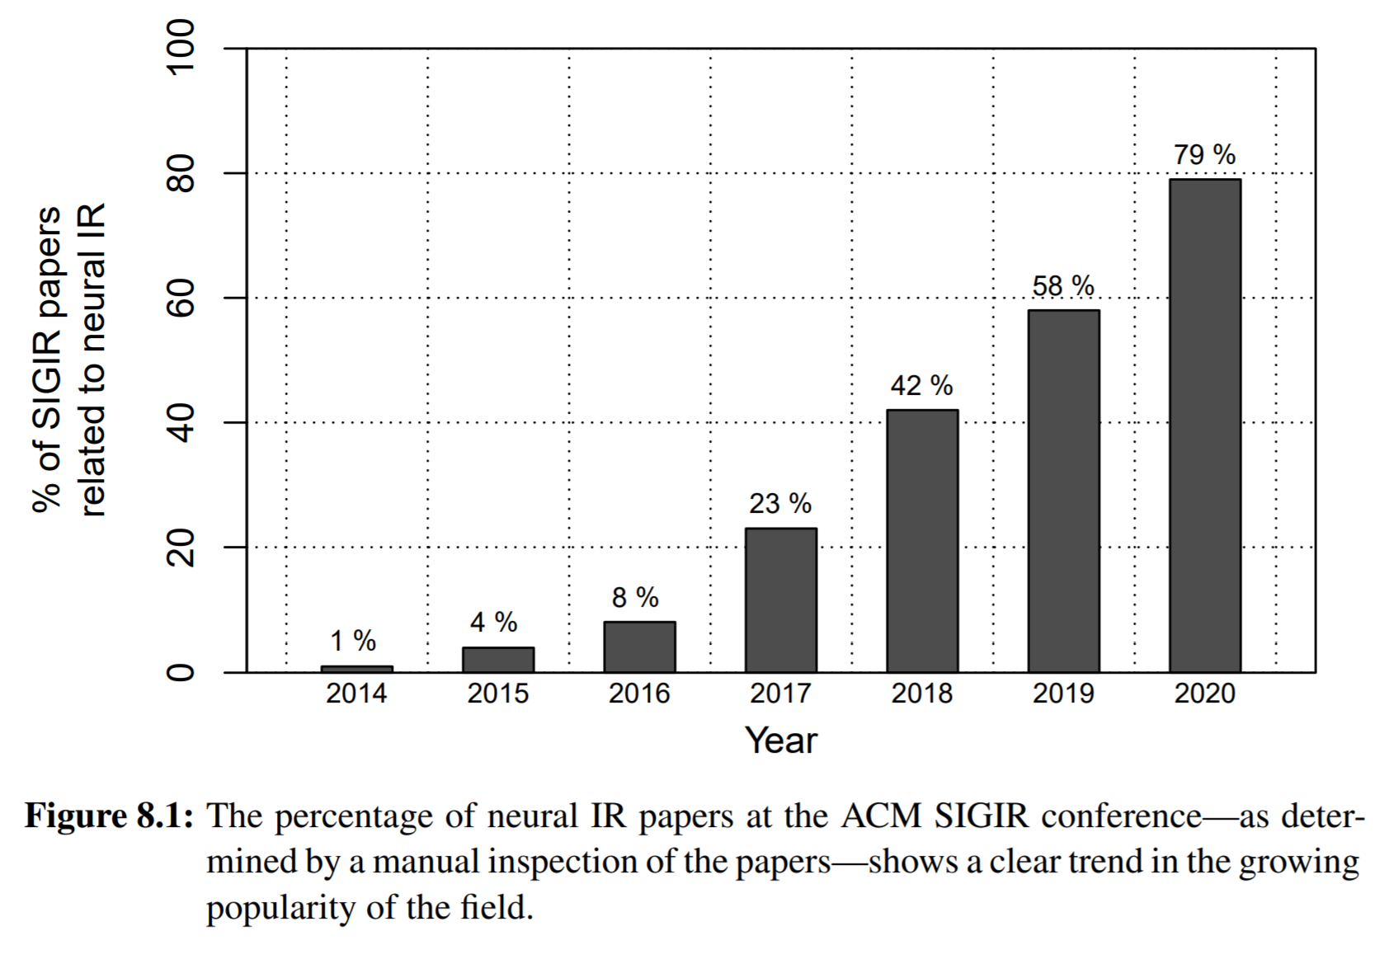
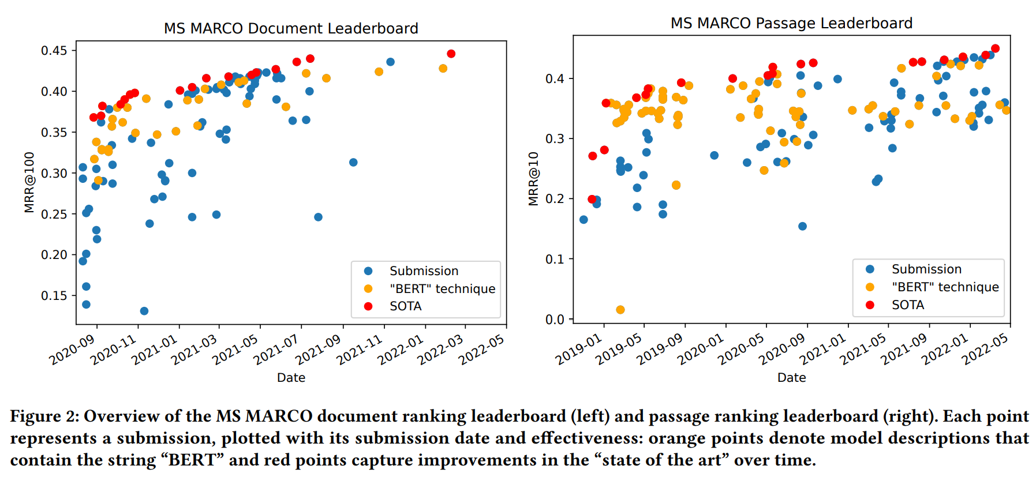
Are we making real progress?
Deep learning models have gone from novelty to commodity in communities like SIGIR—parallels to how learning-to-rank models “took over” IR
Deep models have demonstrated large gains over previous state-of-the-art, and the gap continues to grow
But we must be careful of how we interpret “progress”, and interrogate the evidence when it is largely based on a single benchmark

Slide 13
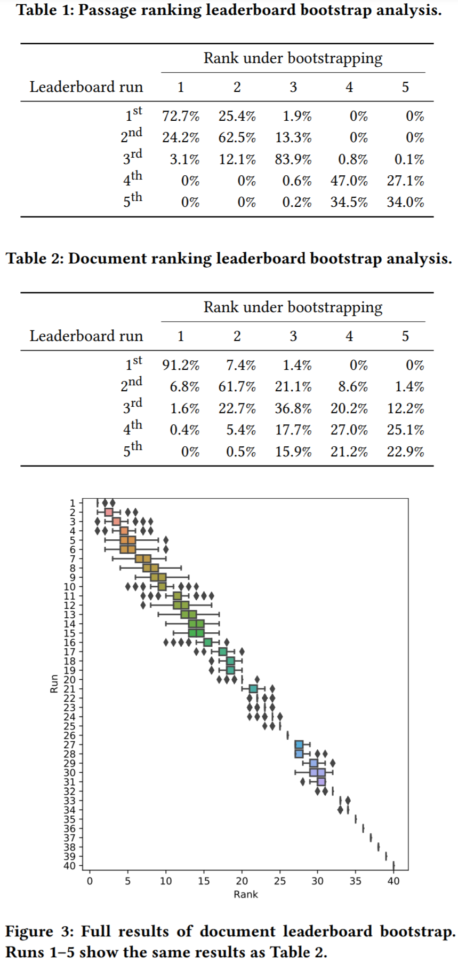
Internal validity. Would improvements on the current dataset hold on a different sample from the same dataset for the same task?
External validity. Would improvements on the current dataset hold on a different dataset with different distribution for the same task or on a different (but closely related) task?
If MS MARCO’s training data is only useful for achieving good results on MS MARCO’s test set, then it’s less useful for the IR community
Important: transfer learning from MS MARCO to other benchmarks
TREC DL is transfer learning (MS MARCO sparse binary labels → NIST’s 5-point labels)
Promising results: MS MARCO → Robust04, TREC-COVID, TREC-CAsT
Under bootstrap analysis we find the leaderboard rankings are stable!
😊👍

Slide 14
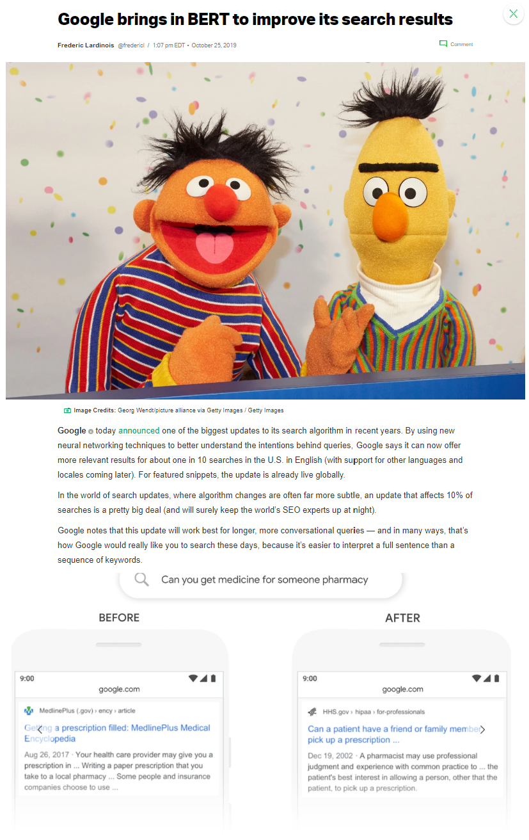

Industry impact
BERT-scale deep ranking models in production search systems

Slide 15
Give a small boy a hammer, and he will find that everything he encounters needs pounding.
“
- Abraham Kaplan
https://en.wikipedia.org/wiki/Law_of_the_instrument
Notes:
We are all familiar with the saying “if all you have is a hammer then everything looks like a nail”.

Slide 16
What’s next?
Short term. In the short term, larger focus is likely to continue making these models more practically useful in real production systems. The emphasis will be on effectiveness, efficiency, and robustness.
Long term. In the longer term, our increased optimization capabilities should support and encourage bolder visions for IR. The three directions I am personally excited about are: (i) Interplay between IR data structures and deep ranking models, (ii) stochastic ranking and direct optimization for target exposure, and (iii) structured knowledge extraction / modeling / retrieval.

Slide 17
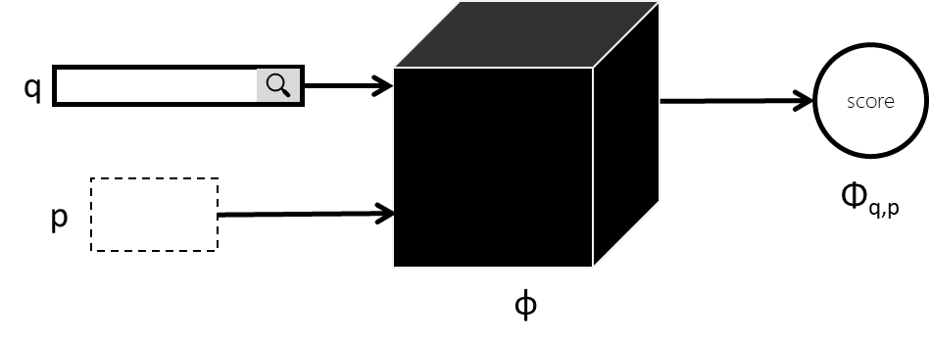
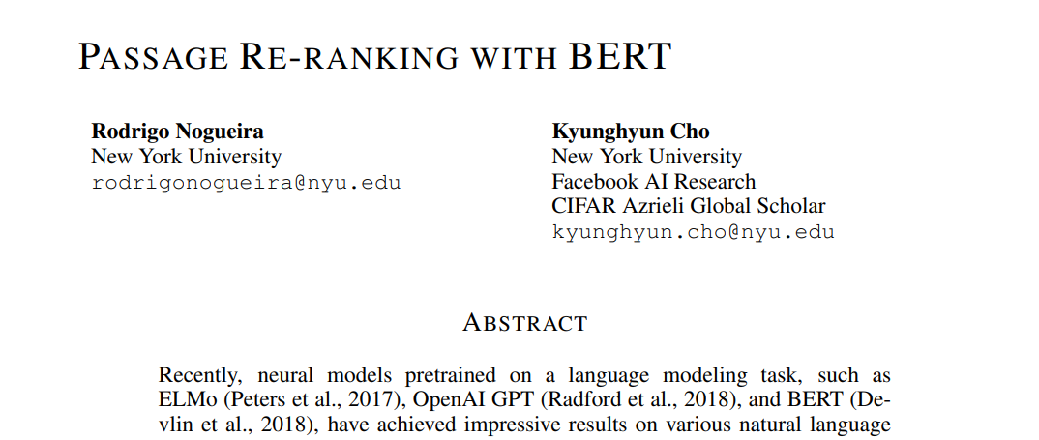
Case studies: Scaling BERT-based relevance models to long documents and full retrieval settings
How do we scale to longer documents?
Bottleneck: Peak GPU memory during training
How do we scale to full retrieval from large collections?
Challenge: Collection size vs. expected online query response time
Nogueira and Cho (2019)
🤔

Slide 18
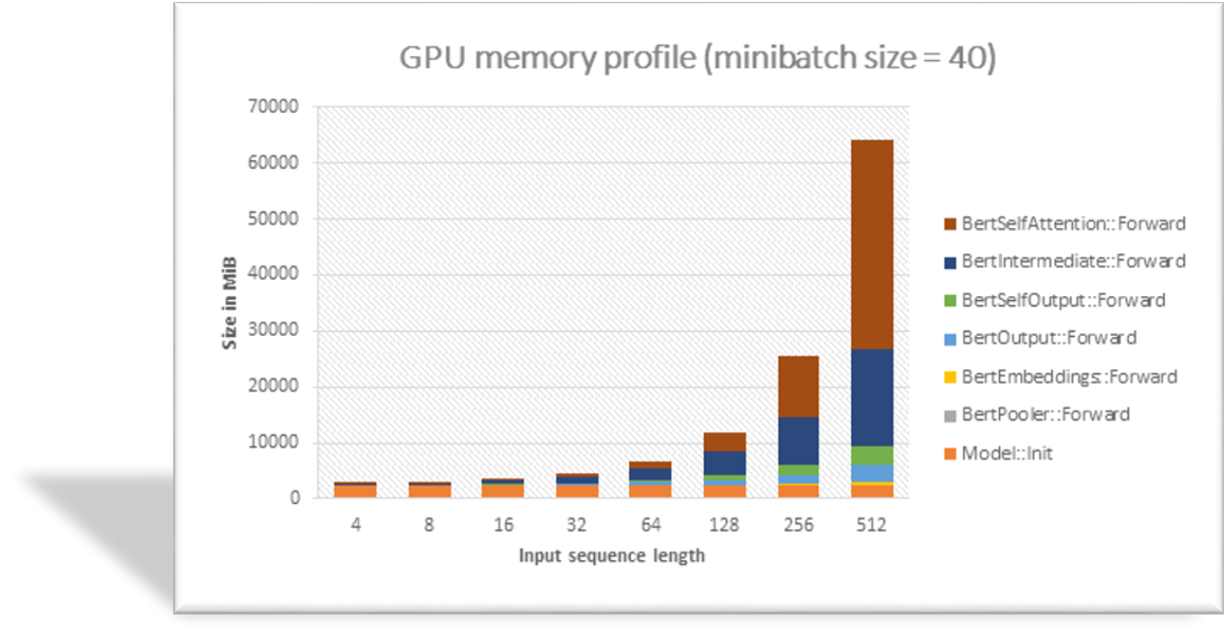
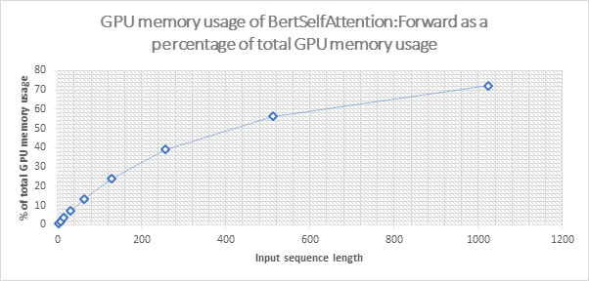
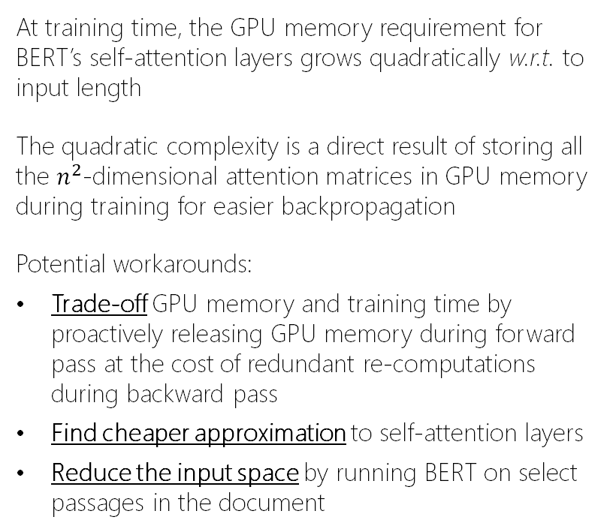
Challenges in scaling BERT to longer inputs
At training time, the GPU memory requirement for BERT’s self-attention layers grows quadratically w.r.t. to input length
The quadratic complexity is a direct result of storing all the $n^{2}$-dimensional attention matrices in GPU memory during training for easier backpropagation
Potential workarounds:
Trade-off GPU memory and training time by proactively releasing GPU memory during forward pass at the cost of redundant re-computations during backward pass
Find cheaper approximation to self-attention layers
Reduce the input space by running BERT on select passages in the document

Slide 19

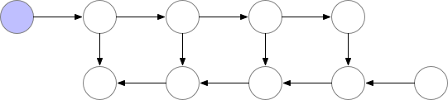
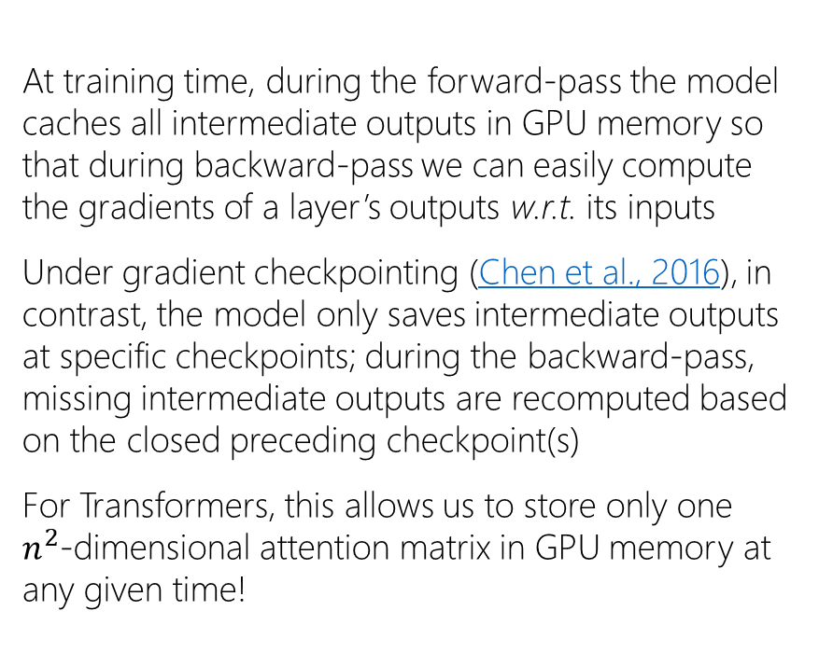
Trade-off GPU memory and training time using gradient checkpointing
At training time, during the forward-pass the model caches all intermediate outputs in GPU memory so that during backward-pass we can easily compute the gradients of a layer’s outputs w.r.t. its inputs
Under gradient checkpointing (Chen et al., 2016), in contrast, the model only saves intermediate outputs at specific checkpoints; during the backward-pass, missing intermediate outputs are recomputed based on the closed preceding checkpoint(s)
For Transformers, this allows us to store only one $n^{2}$-dimensional attention matrix in GPU memory at any given time!
Stored in GPU memory
Without gradient checkpointing:
With gradient checkpointing:
checkpoint
https://medium.com/tensorflow/fitting-larger-networks-into-memory-583e3c758ff9

Slide 20
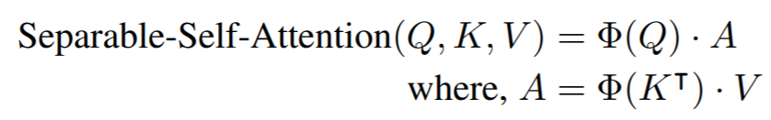
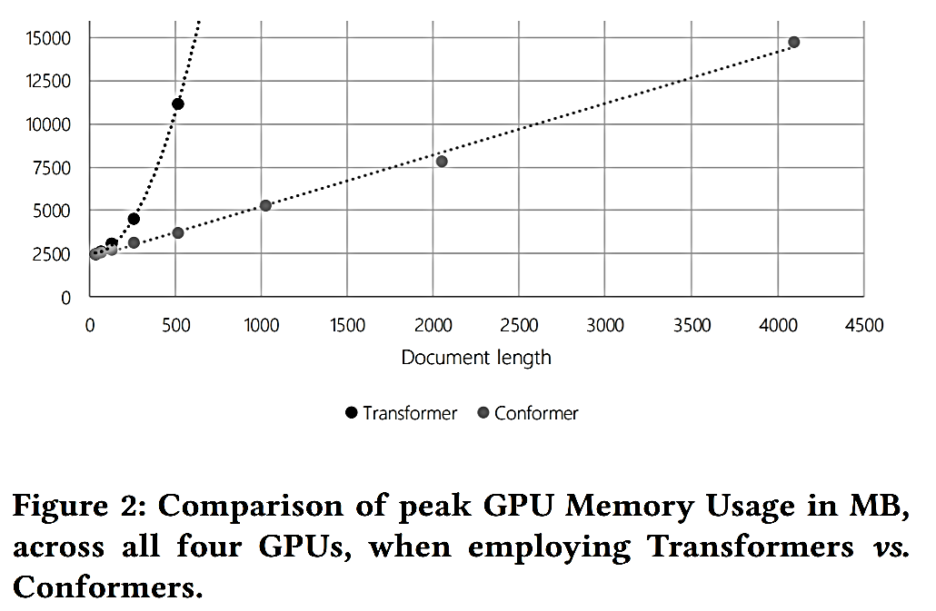
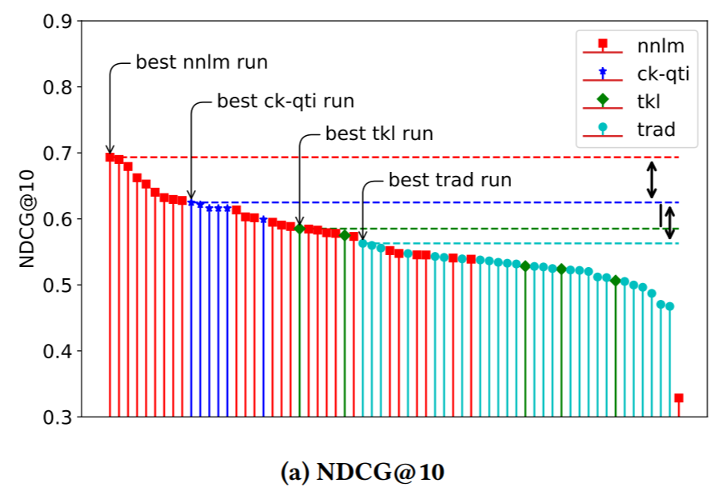
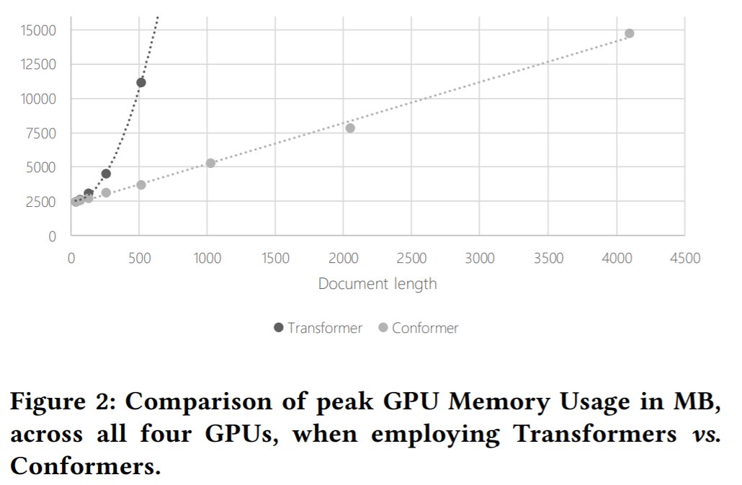
Cheaper approximation: Transformer → Conformer
Conformer is an alternative to Transformer that employs a separable self-attention layer with linear GPU memory complexity (as opposed to Transformer’s quadratic complexity) and is augmented with additional convolutional layers to model short-distance attention
TREC 2020 Deep Learning Track
(Document Ranking Task)
Mitra, Hofstätter, Zamani, and Craswell. Conformer-Kernel with Query Term Independence for Document Retrieval. ArXiv preprint. (2020)
Mitra, Hofstätter, Zamani, and Craswell. Conformer-Kernel with Query Term Independence at TREC 2020 Deep Learning Track. In Proc. TREC. (2020)
Mitra, Hofstätter, Zamani, and Craswell. Improving Transformer-Kernel Ranking Model Using Conformer and Query Term Independence. In Proc. SIGIR. (2021)

Slide 21
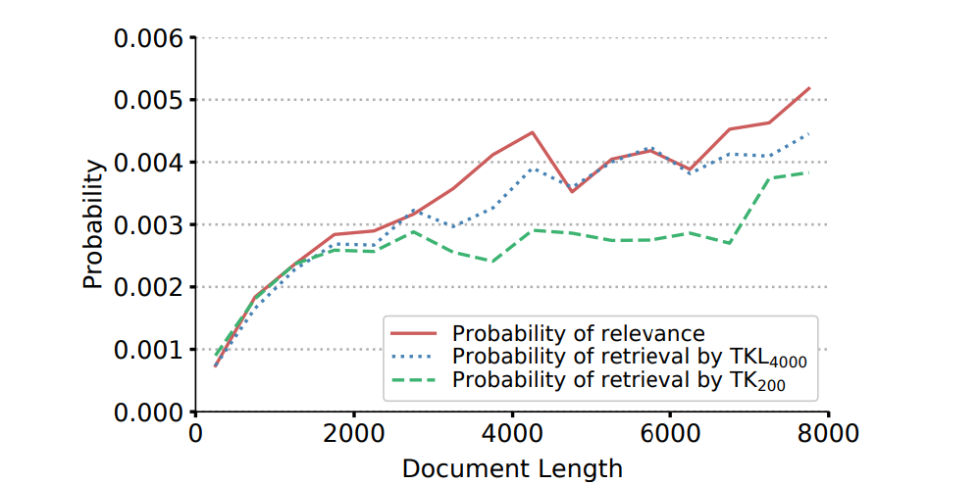
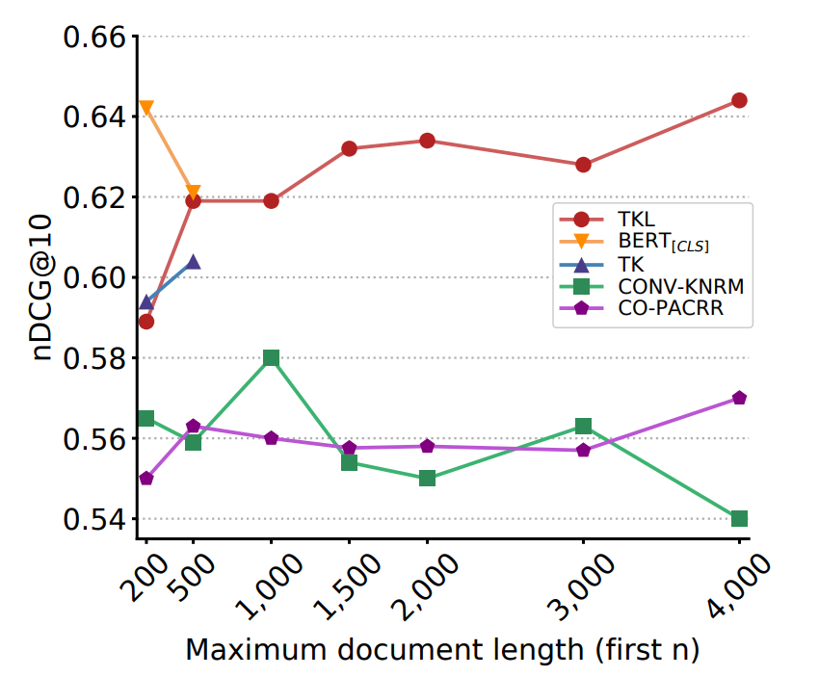
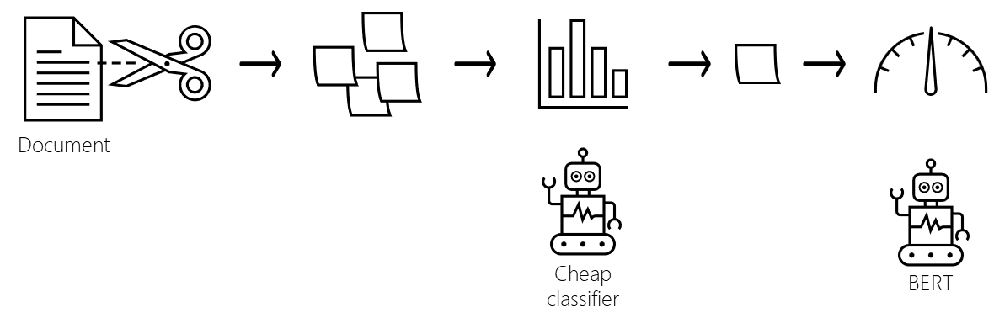
Reduce the task: Passage-based document ranking
Strategy 1: Run BERT on first-k tokens from the document
Considering only the first-k tokens leads to underestimation of relevance and consequently under-retrieval of longer documents (Hofstätter et al., 2020). Recent studies (Kazai et al., 2022) have also analyzed when single snippets are insufficient for both human and machine learning based relevance estimation.
Strategy 2: Run BERT on multiple windows of k-tokens each from the document
This is the approach proposed by Hofstätter et al. (2020). However, the number of windows can be large corresponding to longer documents and running BERT too many times per query-document pair can also be prohibitively costly.
Strategy 3: Run BERT on windows of text pre-selected using cheaper models
This is the approach proposed by Hofstätter et al. (2021). The approach (IDCM) was motivated by cascaded ranking pipelines, but in this case the cascades are employed within-document for passage selection.
Hofstätter, Zamani, Mitra, Craswell, and Hanbury. Local Self-Attention over Long Text for Efficient Document Retrieval. In Proc. SIGIR. (2020)
Hofstätter, Mitra, Zamani, Craswell, and Hanbury. Intra-Document Cascading: Learning to Select Passages for Neural Document Ranking. In Proc. SIGIR. (2021)
Kazai, Mitra, Dong, Zamani, Craswell, and Yang. Less is Less: When Are Snippets Insufficient for Human vs Machine Relevance Estimation? In Proc. ECIR. (2022)

Slide 22
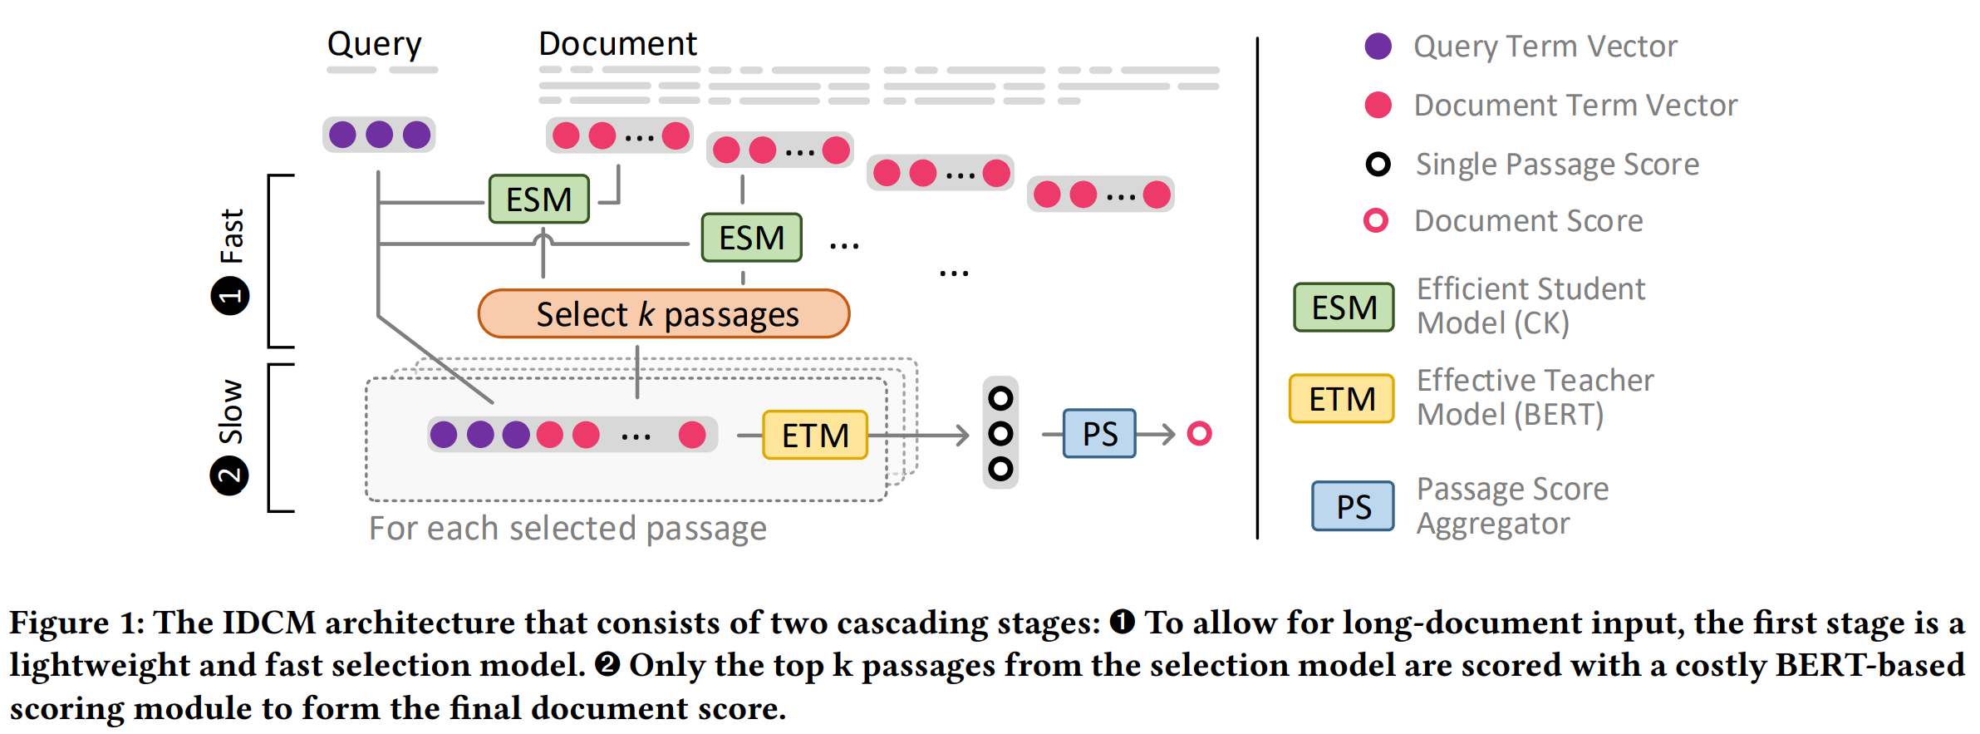
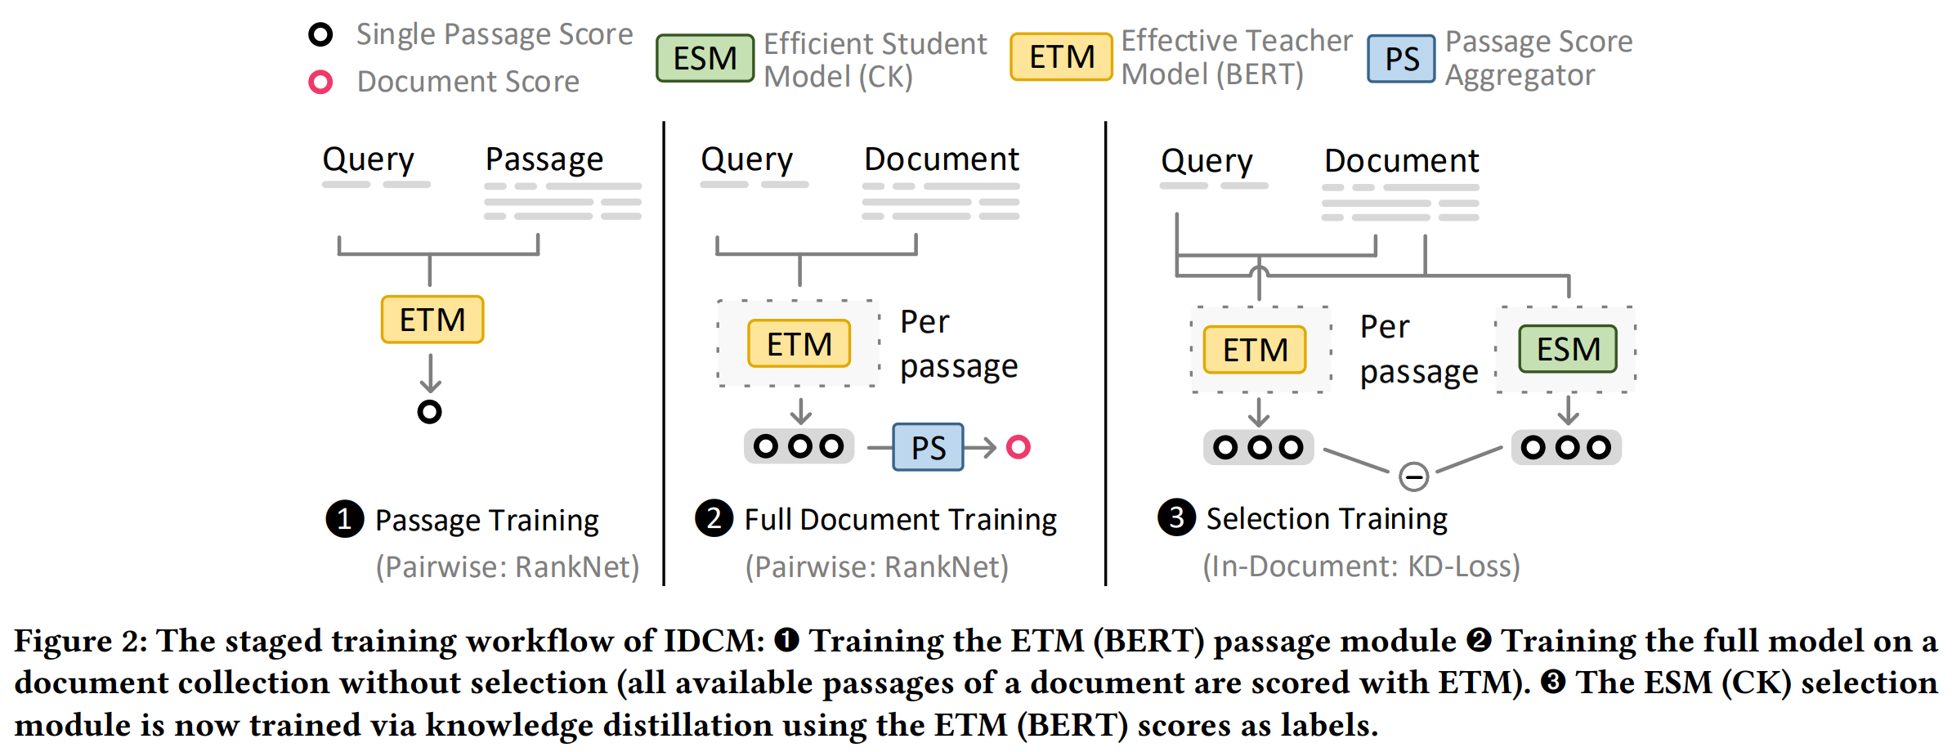
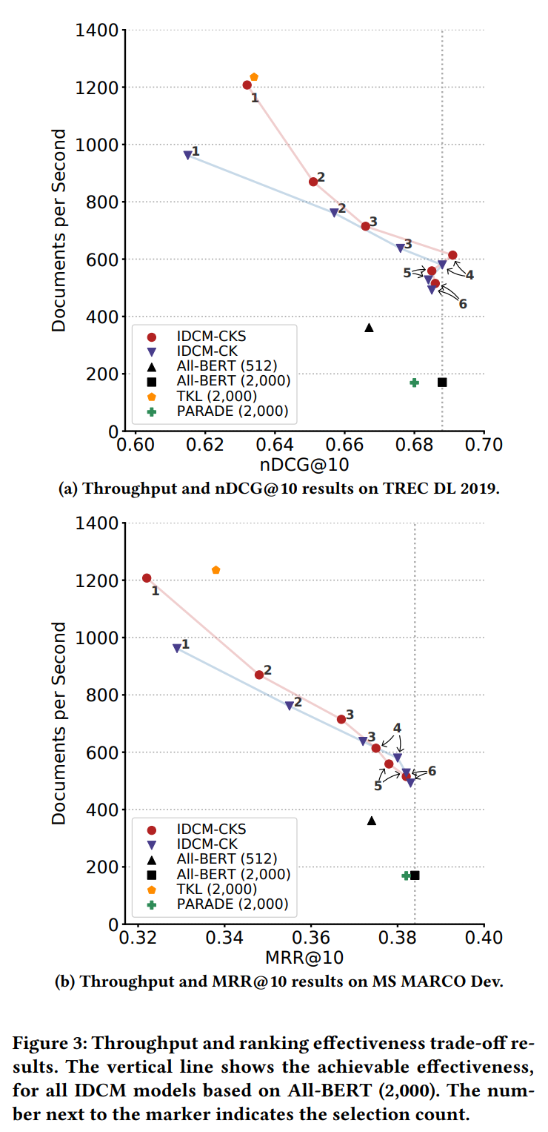
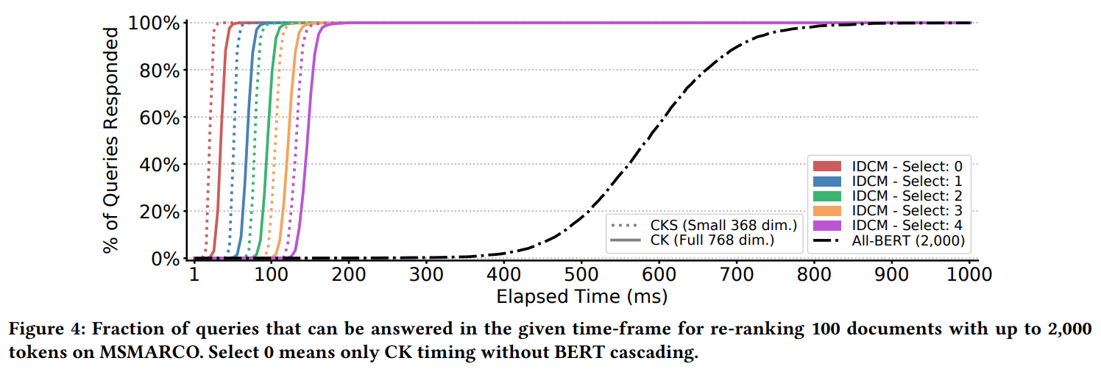
Intra-Document Cascaded Model (IDCM)
We employ a cascaded architecture: a cheaper model ranks-and-prunes candidate passages and costlier BERT model inspects only selected passages from the document
The cheaper model is trained via knowledge distillation from the BERT model
Hofstätter, Mitra, Zamani, Craswell, and Hanbury. Intra-Document Cascading: Learning to Select Passages for Neural Document Ranking. In Proc. SIGIR. (2021)

Slide 23
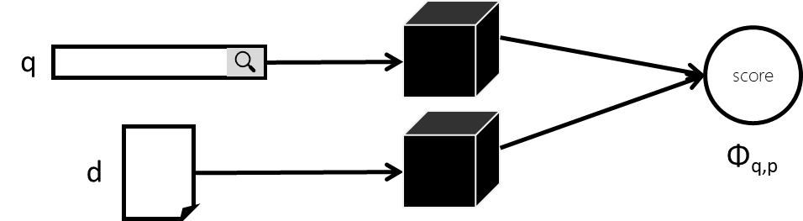
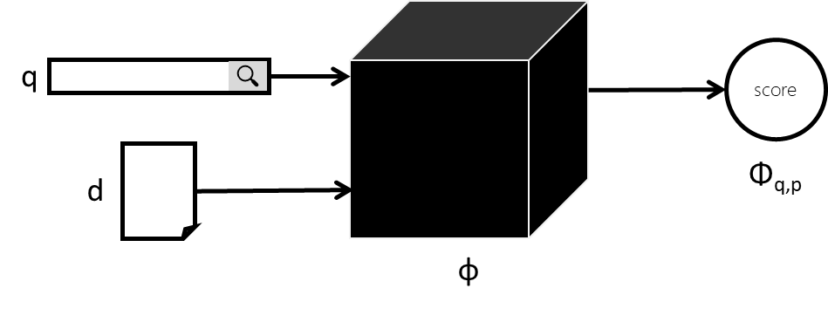
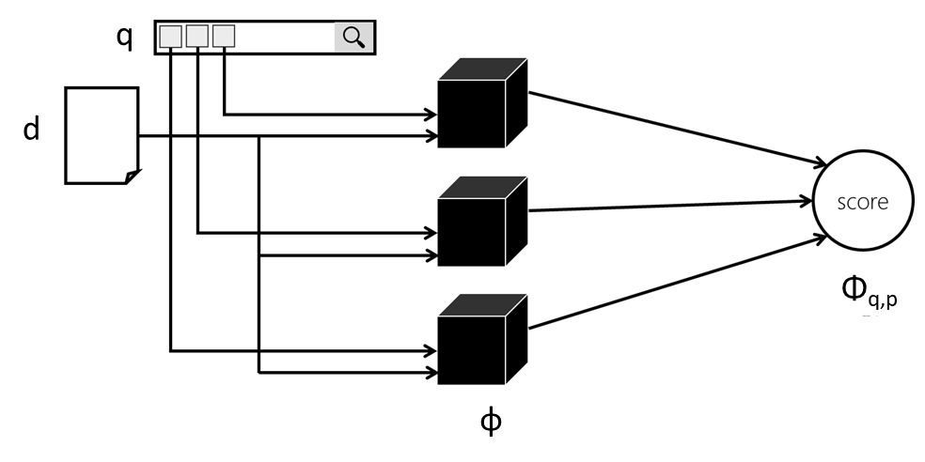
Challenges in scaling BERT to full retrieval
Dense retrieval: Xiong et al. (2021), Qu et al. (2021), Hofstätter et al. (2021), and others
Nogueira and Cho (2019)
Broadly two sets of approaches have emerged: Dense retrieval and Query Term Independent (QTI) models; both precompute document representations at indexing time and require very little computations at query response time
QTI: Mitra et al. (2019), Nogueira et al. (2019), Dai and Callan (2020), and others
Mitra, Rosset, Hawking, Craswell, Diaz, and Yilmaz. Incorporating Query Term Independence Assumption for Efficient Retrieval and Ranking Using Deep Neural Networks. ArXiv preprint. (2019)
Mitra, Hofstätter, Zamani, and Craswell. Conformer-Kernel with Query Term Independence for Document Retrieval. ArXiv preprint. (2020)
Mitra, Hofstätter, Zamani, and Craswell. Conformer-Kernel with Query Term Independence at TREC 2020 Deep Learning Track. In Proc. TREC. (2020)
Mitra, Hofstätter, Zamani, and Craswell. Improving Transformer-Kernel Ranking Model Using Conformer and Query Term Independence. In Proc. SIGIR. (2021)

Slide 24
A note about distillation
A popular recipe involves pretraining/finetuning large models and then knowledge distillation to smaller models that can be deployed in real-world retrieval systems
Pretrained model
e.g., 24-layer BERT
Finetuned model
e.g., 24-layer BERT
Distilled model
e.g., smaller model, or dense retriever, or QTI, or early-stage cascade model

Slide 25
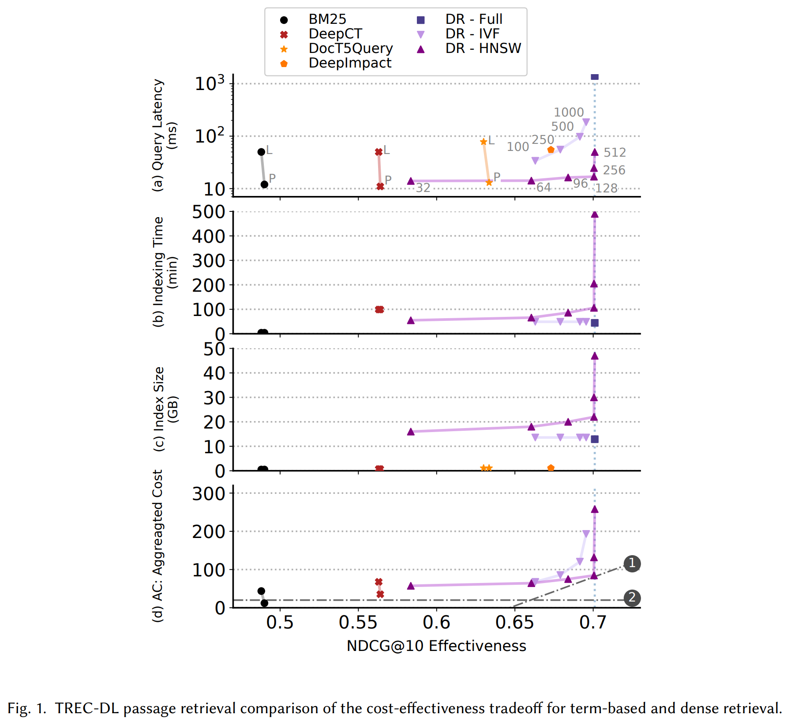

Benchmarking by jointly considering effectiveness, efficiency, and robustness
A preliminary framework:
Identify key measures of effectiveness, efficiency, and robustness
Measures can either be traded-off against each other, or act as guardrails
Apply value-laden and business-informed trade-offs between cost and robustness measures to define aggregate measures, e.g.,
Identify the set of acceptable solutions (again) based on value-laden and business-informed trade-offs decision boundaries
Hofstätter, Craswell, Mitra, Zamani, and Hanbury. Are We There Yet? A Decision Framework for Replacing Term-Based Retrieval with Dense Retrieval Systems. ArXiv preprint. (2022)

Slide 26


Robustness and calibration
In practical scenarios, it is important that these of deep models perform robustly across different domains and distributional shifts over time
It is also important that we look beyond point estimates of relevance and consider calibrated uncertainties in model predictions
Cohen, Mitra, Rosset, Hofmann, and Croft. Cross Domain Regularization for Neural Ranking Models using Adversarial Learning. In Proc. SIGIR. (2018)
Cohen, Mitra, Lesota, Rekabsaz, and Eickhoff. Not All Relevance Scores are Equal: Efficient Uncertainty and Calibration Modeling for Deep Retrieval Models. In Proc. SIGIR. (2021)
Cohen, Du, Mitra, Mercurio, Rekabsaz, and Eickhoff. Inconsistent Ranking Assumptions in Medical Search and Their Downstream Consequences. In Proc. SIGIR. (2022)

Slide 27
Looking further down the road…
Notes:
We are all familiar with the saying “if all you have is a hammer then everything looks like a nail”.

Slide 28


IR data structures and deep ranking models
Kraska et al. (2018) were one of the earliest to propose learned index structures where predictive machine learning is employed to speed up search over classical data structures
I believe there’s a significant opportunity to design data-structure-aware deep ranking models and to employ deep learning to directly optimize for efficiency in our search stacks

Slide 29

Case study:
Optimizing first stage retrieval using reinforcement learning
Rosset, Jose, Ghosh, Mitra, and Tiwary. Optimizing Query Evaluations Using Reinforcement Learning for Web Search. In Proc. SIGIR. (2018)

Slide 30

Large scale IR systems trade-off search result quality and query response time
In Bing, we have a candidate generation stage followed by multiple rank and prune stages
Typically, we apply machine learning in the re-ranking stages
In this work, we explore reinforcement learning for effective and efficient candidate generation
Rosset, Jose, Ghosh, Mitra, and Tiwary. Optimizing Query Evaluations Using Reinforcement Learning for Web Search. In Proc. SIGIR. (2018)

Slide 31
In Bing, the index is distributed over multiple machines
For candidate generation, on each machine the documents are linearly scanned using a match plan
Rosset, Jose, Ghosh, Mitra, and Tiwary. Optimizing Query Evaluations Using Reinforcement Learning for Web Search. In Proc. SIGIR. (2018)

Slide 32
When a query comes in, it is automatically categorized, and a pre-defined match plan is selected
A match rule defines the condition that a document should satisfy to be selected as a candidate
A match plan consists of a sequence of match rules, and corresponding stopping criteria
The stopping criteria decides when the index scan using a particular match rule should terminate—and if the matching process should continue with the next match rule, or conclude, or reset to the beginning of the index
Rosset, Jose, Ghosh, Mitra, and Tiwary. Optimizing Query Evaluations Using Reinforcement Learning for Web Search. In Proc. SIGIR. (2018)

Slide 33
Match plans influence the trade-off between effectiveness and efficiency
E.g., long queries with rare intents may require expensive match plans that consider body text and search deeper into the index
In contrast, for popular navigational queries a shallow scan against URL and title metastreams may be sufficient
Rosset, Jose, Ghosh, Mitra, and Tiwary. Optimizing Query Evaluations Using Reinforcement Learning for Web Search. In Proc. SIGIR. (2018)

Slide 34
E.g.,
Query: halloween costumes
Match rule: mr_{A} → (halloween ∈ A|U|B|T ) ∧ (costumes ∈ A|U|B|T )
Query: facebook login
Match rule: mr_{B} → (facebook ∈ U|T )
Rosset, Jose, Ghosh, Mitra, and Tiwary. Optimizing Query Evaluations Using Reinforcement Learning for Web Search. In Proc. SIGIR. (2018)

Slide 35
During execution, two accumulators are tracked
u: the number of blocks accessed from disk
v: the cum. number of term matches in all inspected documents
A stopping criteria sets thresholds for each – when either thresholds are met, the scan using that particular match rule terminates
Matching may then continue with a new match rule, or terminate, or re-start from beginning
Rosset, Jose, Ghosh, Mitra, and Tiwary. Optimizing Query Evaluations Using Reinforcement Learning for Web Search. In Proc. SIGIR. (2018)

Slide 36










Optimizing query evaluations using reinforcement learning
Learn a policy π_{θ} : S → A which maximizes the cumulative discounted reward R, where γ is the discount rate
We employ table-based Q learning
State space: index blocks accessed (u_{t}) and term matches (v_{t})
Action space:
Reward function:
g(d_{i}) is the relevance of the i^{th} document estimated based on the subsequent L1 ranker score—considering only top n documents
index
accumulators(u, v)
match rule
relevance discounted by index blocks accessed
agent
Rosset, Jose, Ghosh, Mitra, and Tiwary. Optimizing Query Evaluations Using Reinforcement Learning for Web Search. In Proc. SIGIR. (2018)

Slide 37

Search as a mediator of exposure
Traditional IR is concerned with ranking items according to relevance
These information access systems deployed at web-scale mediate what information / items gets exposure
In many search scenarios it may be more appropriate to optimize for exposure rather than rank-based metrics; it may also allow us to move towards richer presentation schemes beyond ranked lists
Also, important in the context of fair ranking!

Slide 38





Stochastic ranking and expected exposure
A stochastic ranking model samples a ranking from a probability distribution over all possible permutations of items in the collection—i.e., for the same intent it returns a slightly different ranking on each impression
restaurants in montreal
restaurants in montreal
restaurants in montreal
restaurants in montreal
In recommendation, Diaz et al. (2020) define a stochastic ranking policy 𝜋_{𝑢}, conditioned on user 𝑢 ∈ U, as a probability distribution over all permutations of items in the collection
The expected exposure of an item 𝑑 for user 𝑢 can then be computed as follows:
Here, 𝑝(𝜖|𝑑,𝜎) can be computed using a user browsing model like RBP as discussed previously
Diaz, Mitra, Ekstrand, Biega, and Carterette. Evaluating stochastic rankings with expected exposure. In Proc. CIKM. Best full paper honorable mention. (2020)
Wu*, Mitra*, Ma, Diaz, and Liu (*equal contributions). Joint Multisided Exposure Fairness for Recommendation. In Proc. SIGIR. (2022)

Slide 39








Gradient-based optimization for target exposure
items
neural scoring function
add independently sampled Gumbel noise
compute smooth rank value
compute exposure using user model
compute average exposure
compute loss with target exposure
target exposure
Diaz, Mitra, Ekstrand, Biega, and Carterette. Evaluating stochastic rankings with expected exposure. In Proc. CIKM. Best full paper honorable mention. (2020)
Wu*, Mitra*, Ma, Diaz, and Liu (*equal contributions). Joint Multisided Exposure Fairness for Recommendation. In Proc. SIGIR. (2022)

Slide 40


What query exposes me (or my document)?
Exposing query Identification (EQI)
Given a document and a specified document retrieval system, the exposing query retrieval system retrieves a list of queries from a log ranked by how prominently the document is exposed by the query when searched against the document retrieval system
######
* * * * * *
@@@@@@
Document retrieval
Given a user-specified query, the document retrieval system retrieves a list of documents from a collection ranked by their estimated relevance to the query
######
* * * * * *
@@@@@@ * * * * * *
######

Slide 41


EQI for dense retrieval models (a.k.a., “Reverse”-ing ANCE)
Given a query , the document retrieval system performs a nearest neighbor search over documents
Given a document , the EQI system performs a reverse nearest neighbor search over queries
a query
a document
In our preliminary study, we try to learn new metric spaces (ANCE-append and ANCE-residual) such that a nearest neighbor search in the new space approximates reverse nearest neighbor search in the original dense retrieval embedding space
We compare their performance with nearest neighbor search in the original metric space (ANCE-reverse)
Li, Li, Mitra, Diaz, and Biega. Exposing Query Identification for Search Transparency. In Proc. TheWebConf, ACM. (2022)

Slide 42

Structured knowledge
An exciting challenge for deep learning in the context of information access is how to handle multimodal and structured information
Applications include automatic knowledge base construction (e.g., Project Alexandria), structured item retrieval (e.g., product search, document retrieval with multiple fields), and KB-augmented machine learning
My personal research is moving towards this direction and hopefully I will have more to report on this in the coming year 🙂
Zamani, Mitra, Song, Craswell, and Tiwary. Neural Ranking Models with Multiple Document Fields. In Proc. WSDM. (2018)

Slide 43





Thank you!
http://bit.ly/fntir-neural
@UnderdogGeek
bmitra@microsoft.com

